Slide 1
Clustering Metrics

Slide 2
What is Cluster Analysis?
Cluster: a collection of data objects
Similar to one another within the same cluster
Dissimilar to the objects in other clusters
Cluster analysis
Grouping a set of data objects into clusters
Clustering is unsupervised classification: no predefined classes
Typical applications
As a stand-alone tool to get insight into data distribution
As a preprocessing step for other algorithms

Slide 3
What Is Good Clustering?
A good clustering method will produce high quality clusters with
high intra-class similarity
low inter-class similarity
The quality of a clustering result depends on both the similarity measure used by the method and its implementation.
The quality of a clustering method is also measured by its ability to discover some or all of the hidden patterns.

Slide 4
Problem with clustering
Any algorithm will deliver some clusters.
No clustering algorithm exists without parameters affecting the number of detected clusters
We should always test how far the discovered structure in the data is from ‘random’ data.
Using built-in optimization criteria is not a good idea.
Some data are not naturally ‘clusterable’.

Slide 5
Here are a few scenarios where data might not be naturally "clusterable":
Uniform Data: If your data is distributed uniformly or lacks any discernible patterns, it might not exhibit clear clusters.
Noisy Data: When there is a significant amount of noise in the data, it can obscure genuine cluster structures.
Overlapping Clusters: If clusters in the data overlap significantly, it can make it challenging to separate them distinctly.
Sparse Data: In high-dimensional spaces, data points tend to become more spread out, making it difficult to identify compact clusters.
Outliers: Outliers can significantly affect the determination of cluster centers and boundaries.

Slide 6
Here are some reasons why using optimization criteria alone might be insufficient:
Assumption Mismatch: Built-in optimization criteria are often based on certain assumptions about the data, such as cluster shapes or densities. If these assumptions don't hold in your data, the criteria might lead to suboptimal results.
Overfitting: Some optimization criteria can lead to overfitting, where the algorithm tries to fit noise or outliers as if they were meaningful clusters. This can result in overly complex or inaccurate cluster assignments.
Sensitivity to Noise: Optimization criteria might be sensitive to noise or outliers, causing the algorithm to create clusters around these noisy points.
Arbitrary Metrics: Some optimization criteria might not necessarily align with the practical goals of your analysis. Maximizing certain metrics doesn't always lead to clusters that make sense in the context of your data.
Choosing Parameters: Optimization criteria often involve parameters that need to be chosen beforehand. Picking the right parameters can be challenging and can greatly impact the resulting clusters.

Slide 7
Basic questions
Did we capture any non-random structure in the data?
Did we choose the parameters (e.g., number of clusters) in the most optimal way?
Do our clusters make sense in the application domain?

Slide 8
Standard protocol for testing cluster validity
Identify the clustering structure and validation type
Define a validation index
Define a null hypothesis of no structure (for example, all the locations of data points in the specific regions are equally likely)
Establish the baseline distribution under the null hypothesis (for example, by bootstrapping, resampling or permutations)
Calculate the index
Test the hypothesis of no structure

Slide 9
Here's a detailed breakdown of each step:
Identify the Clustering Structure and Validation Type: Understand the type of clustering structure you're dealing with (e.g., density-based, partition-based) and choose an appropriate validation method based on your goals and data characteristics.
Define a Validation Index: Choose a validation index or metric that quantifies the quality of the clustering. Examples include silhouette score, Davies-Bouldin index, and normalized mutual information. The index should reflect the desired properties of your clusters (e.g., compactness, separation, alignment with ground truth).
Define a Null Hypothesis of No Structure: Establish a null hypothesis that assumes there is no meaningful clustering structure in the data. For example, you might assume that data points are distributed uniformly or randomly.

Slide 10
Establish the Baseline Distribution Under the Null Hypothesis: Generate a baseline distribution that represents the null hypothesis. This can be done through bootstrapping, resampling, or permutations. The idea is to simulate what clustering patterns might arise by random chance.
Calculate the Index: Calculate the chosen validation index for both the actual clustering result and the baseline distribution. This step quantifies how well the observed clusters perform compared to random chance.
Test the Hypothesis of No Structure: Compare the calculated index for the actual clustering result with the distribution of indices obtained from the baseline distribution. Use statistical tests to determine whether the observed index significantly deviates from what you'd expect by random chance.

Slide 11
Measure the Quality of Clustering
Dissimilarity/Similarity metric: Similarity is expressed in terms of a distance function, which is typically metric: d(i, j)
There is a separate “quality” function that measures the “goodness” of a cluster.
The definitions of distance functions are usually very different for interval-scaled, boolean, categorical, ordinal and ratio variables.
Weights should be associated with different variables based on applications and data semantics.
It is hard to define “similar enough” or “good enough”
the answer is typically highly subjective.

Slide 12
It emphasizes the importance of considering the nature of the data, the goals of clustering, and the domain expertise when assessing the quality of clusters.
It acknowledges that clustering is not a purely objective process and often involves making informed judgments about what constitutes meaningful patterns.

Slide 13
Considerations for Cluster Analysis
Partitioning criteria
Single level vs. hierarchical partitioning (often, multi-level hierarchical partitioning is desirable)
Separation of clusters
Exclusive (e.g., one customer belongs to only one region) vs. non-exclusive (e.g., one document may belong to more than one class)
Similarity measure
Distance-based (e.g., Euclidian, road network, vector) vs. connectivity-based (e.g., density or contiguity)
Clustering space
Full space (often when low dimensional) vs. subspaces (often in high-dimensional clustering)
13

Slide 14
Requirements and Challenges
Scalability
Clustering all the data instead of only on samples
Ability to deal with different types of attributes
Numerical, binary, categorical, ordinal, linked, and mixture of these
Constraint-based clustering
User may give inputs on constraints
Use domain knowledge to determine input parameters
Interpretability and usability
Others
Discovery of clusters with arbitrary shape
Ability to deal with noisy data
Incremental clustering and insensitivity to input order
High dimensionality
14
Notes:
Incremental clustering and insensitivity to input order: Suppose new points come. Do you need to recluster from scratch?
High dimensionality: Human eye is good only for 2-3 dimensions

Slide 15
Measuring Clustering Quality
Two methods: extrinsic vs. intrinsic
Extrinsic: supervised, i.e., the ground truth is available
Compare a clustering against the ground truth using certain clustering quality measure
Ex. BCubed precision and recall metrics
Intrinsic: unsupervised, i.e., the ground truth is unavailable
Evaluate the goodness of a clustering by considering how well the clusters are separated, and how compact the clusters are
Ex. Silhouette coefficient
15

Slide 16
Type of data in clustering analysis
Interval-scaled variables:
Binary variables:
Nominal, ordinal, and ratio variables:
Variables of mixed types:

Slide 17
Interval-valued variables
Standardize data
Calculate the mean absolute deviation:
where
Calculate the standardized measurement (z-score)
Using mean absolute deviation is more robust than using standard deviation

Slide 18
Similarity and Dissimilarity Between Objects
Distances are normally used to measure the similarity or dissimilarity between two data objects
Some popular ones include: Minkowski distance:
where i = (x_{i1}, x_{i2}, …, x_{ip}) and j = (x_{j1}, x_{j2}, …, x_{jp}) are two p-dimensional data objects, and q is a positive integer
If q = 1, d is Manhattan distance

Slide 19
Similarity and Dissimilarity Between Objects (Cont.)
If q = 2, d is Euclidean distance:
Properties
d(i,j) ≥ 0
d(i,i) = 0
d(i,j) = d(j,i)
d(i,j) ≤ d(i,k) + d(k,j)
Also one can use weighted distance, parametric Pearson product moment correlation, or other disimilarity measures.

Slide 20
Binary Variables
A contingency table for binary data
Simple matching coefficient (invariant, if the binary variable is symmetric):
Jaccard coefficient (noninvariant if the binary variable is asymmetric):
Object j
Object i

Slide 21
Nominal Variables
A generalization of the binary variable in that it can take more than 2 states, e.g., red, yellow, blue, green
Method 1: Simple matching
m: # of matches, p: total # of variables
Method 2: use a large number of binary variables
creating a new binary variable for each of the M nominal states

Slide 22
Ordinal Variables
An ordinal variable can be discrete or continuous
order is important, e.g., rank
Can be treated like interval-scaled
replacing x_{if} by their rank
compute the dissimilarity using methods for interval-scaled variables

Slide 23
Ratio-Scaled Variables
Ratio-scaled variable: a positive measurement on a nonlinear scale, approximately at exponential scale, such as Ae^{Bt} or Ae^{-Bt}
Methods:
treat them like interval-scaled variables — not a good choice! (why?)
apply logarithmic transformation
y_{if} = log(x_{if})
treat them as continuous ordinal data treat their rank as interval-scaled.

Slide 24
Variables of Mixed Types
A database may contain all the six types of variables
symmetric binary, asymmetric binary, nominal, ordinal, interval and ratio.
One may use a weighted formula to combine their effects.
f is binary or nominal:
d_{ij}^{(f)} = 0 if x_{if} = x_{jf} , or d_{ij}^{(f)} = 1 o.w.
f is interval-based: use the normalized distance
f is ordinal or ratio-scaled
compute ranks r_{if} and
and treat z_{if} as interval-scaled

Slide 25
Clustering Validation
Clustering Validation: Basic Concepts
Clustering Evaluation: Measuring Clustering Quality
External Measures for Clustering Validation
I: Matching-Based Measures
II: Entropy-Based Measures
III: Pairwise Measures
Internal Measures for Clustering Validation
Relative Measures
Cluster Stability
Clustering Tendency

Slide 26
Clustering Validation and Assessment
Major issues on clustering validation and assessment
Clustering evaluation
Evaluating the goodness of the clustering
Clustering stability
To understand the sensitivity of the clustering result to various algorithm parameters, e.g., # of clusters
Clustering tendency
Assess the suitability of clustering, i.e., whether the data has any inherent grouping structure

Slide 27
Measuring Clustering Quality
Clustering Evaluation: Evaluating the goodness of clustering results
No commonly recognized best suitable measure in practice
Three categorization of measures: External, internal, and relative
External: Supervised, employ criteria not inherent to the dataset
Compare a clustering against prior or expert-specified knowledge (i.e., the ground truth) using certain clustering quality measure
Internal: Unsupervised, criteria derived from data itself
Evaluate the goodness of a clustering by considering how well the clusters are separated and how compact the clusters are, e.g., silhouette coefficient
Relative: Directly compare different clusterings, usually those obtained via different parameter settings for the same algorithm

Slide 28
Measuring Clustering Quality: External Methods
Given the ground truth T, Q(C, T) is the quality measure for a clustering C
Q(C, T) is good if it satisfies the following four essential criteria
Cluster homogeneity
The purer, the better
Cluster completeness
Assign objects belonging to the same category in the ground truth to the same cluster
Rag bag better than alien
Putting a heterogeneous object into a pure cluster should be penalized more than putting it into a rag bag (i.e., “miscellaneous” or “other” category)
Small cluster preservation
Splitting a small category into pieces is more harmful than splitting a large category into pieces

Slide 29
Commonly Used External Measures
Matching-based measures
Purity, maximum matching, F-measure
Entropy-Based Measures
Conditional entropy
Normalized mutual information (NMI)
Variation of information
Pairwise measures
Four possibilities: True positive (TP), FN, FP, TN
Jaccard coefficient, Rand statistic, Fowlkes-Mallow measure
Correlation measures
Discretized Huber static, normalized discretized Huber static
Ground truth partitioning T₁
T₂
Cluster C₁
Cluster C₂

Slide 30
Cluster Validity Metrics - Compactness
One good goal is compactness – members of a cluster are all similar and close together
One measure of compactness of a cluster is the SSE of the cluster instances compared to the cluster centroid
where c is the centroid of a cluster C, made up of instances X_{c}. Lower is better.
Thus, the overall compactness of a particular clustering is just the sum of the compactness of the individual clusters
Gives us a numeric way to compare different clusterings by seeking clusterings which minimize the compactness metric
Notes:
Square the eulclidean distance (distance usually Euclidean)
One cluster per node. However, for a set k and just trying to compare different solutions with that k, then compactness would be a reasonable measure (e.g. k-means comparisons). Save this for k-means discussion.

Slide 31
Cluster Validity Metrics - Separability
Another good goal is separability – members of one cluster are sufficiently different from members of another cluster (cluster dissimilarity)
One measure of the separability of two clusters is their squared distance. The bigger the distance the better.
dist_{ij} = (c_{i} - c_{j})² where c_{i} and c_{j} are two cluster centroids
Notes:
Note no square root on distance. Same ranking, just a normalization decision.
The cluster to which each cluster is closest

Slide 32
Cluster Validity Metrics - Separability
Another good goal is separability – members of one cluster are sufficiently different from members of another cluster (cluster dissimilarity)
One measure of the separability of two clusters is their squared distance. The bigger the distance the better.
dist_{ij} = (c_{i} - c_{j})² where c_{i} and c_{j} are two cluster centroids
For a clustering which cluster distances should we compare?
For each cluster we add in the distance to its closest neighbor cluster
We would like to find clusterings where separability is maximized
However, separability is usually maximized when there are are very few clusters
squared distance amplifies larger distances

Slide 33
Silhouette
Want techniques that find a balance between inter-cluster similarity and intra-cluster dissimilarity
Silhouette is one good popular approach
Scores any clustering with an arbitrary number of unique clusters. Clustering can come from any clustering algorithm.
a(i) = average dissimilarity of instance i to all other instances in the cluster to which i is assigned – Want it small
Dissimilarity could be Euclidian distance, etc.
b(i) = the smallest average dissimilarity of instance i to all instances in the closest cluster to b(i) – Want it large
b(i) is smallest for the best different cluster that i could be assigned to – the best cluster that you would move i to if needed
Notes:
Draw picture here with 3 clusters and show a(i) and b(i).

Slide 34
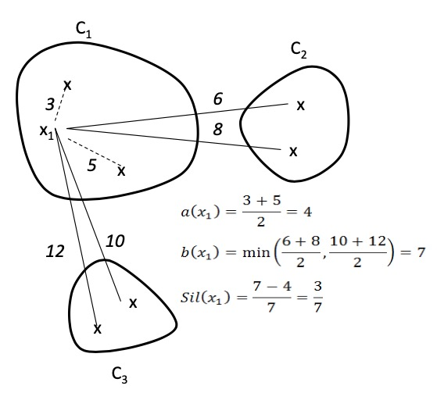
Silhouette
or 1– 4/7 = 3/7
Notes:
Use equation on right, more compact – almost always b(i) will be the max
S(i) = 0 if i is only instance in the cluster, else all nodes by themselves would maximize score
Use picture with 3 clusters to show points of .9, 0, and -.9
Can only be -1, only happens if b(i) = 0, if there is only one cluster

Slide 35
Silhouette
s(i) is close to one when “within” similarity is much smaller than smallest “between” similarity
s(i) is 0 when i is right on the border between two clusters
s(i) is negative when i probably belongs in another cluster
By definition, s(i) = 0 if it is the only node in the cluster
The quality of a single cluster can be measured by the average silhouette score of its members, (close to 1 is best)
The quality of a total clustering can be measured by the average silhouette score of all the instances
To find best clustering, compare total silhouette scores across clusterings with different k values and choose the highest
Notes:
Use equation on right, more compact – almost always b(i) will be the max
S(i) = 0 if i is only instance in the cluster, else all nodes by themselves would maximize score
Use picture with 3 clusters to show points of .9, 0, and -.9
Can only be -1, only happens if b(i) = 0, if there is only one cluster

Slide 36
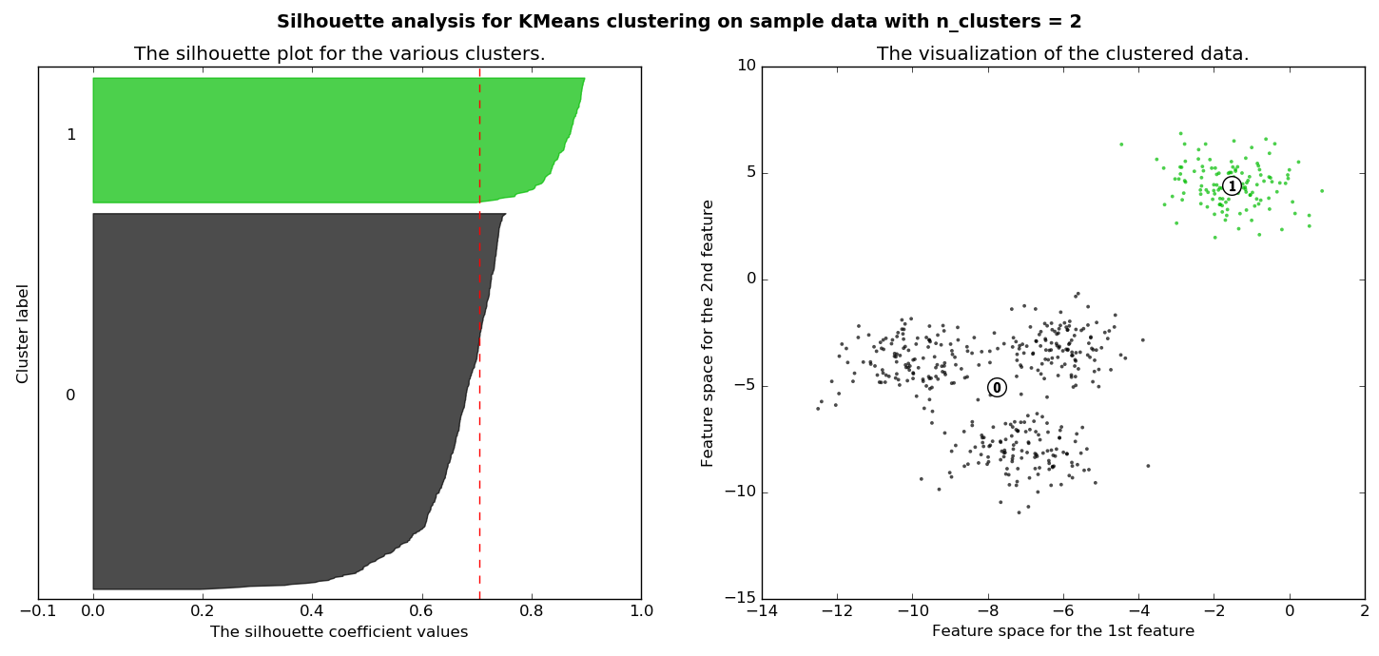
Visualizing Silhouette
Width is quality of cluster, height is size of cluster
Dashed line is average silhouette score for clustering
Notes:
Why does cluster 1 hafe a higher score?
Would if there was a point right between. Would be 0 on one of them, or a mis-clustered point, would be negative
S(i) of point at left of 0 vs right of 0? (both same a(i) but different b(i)

Slide 37
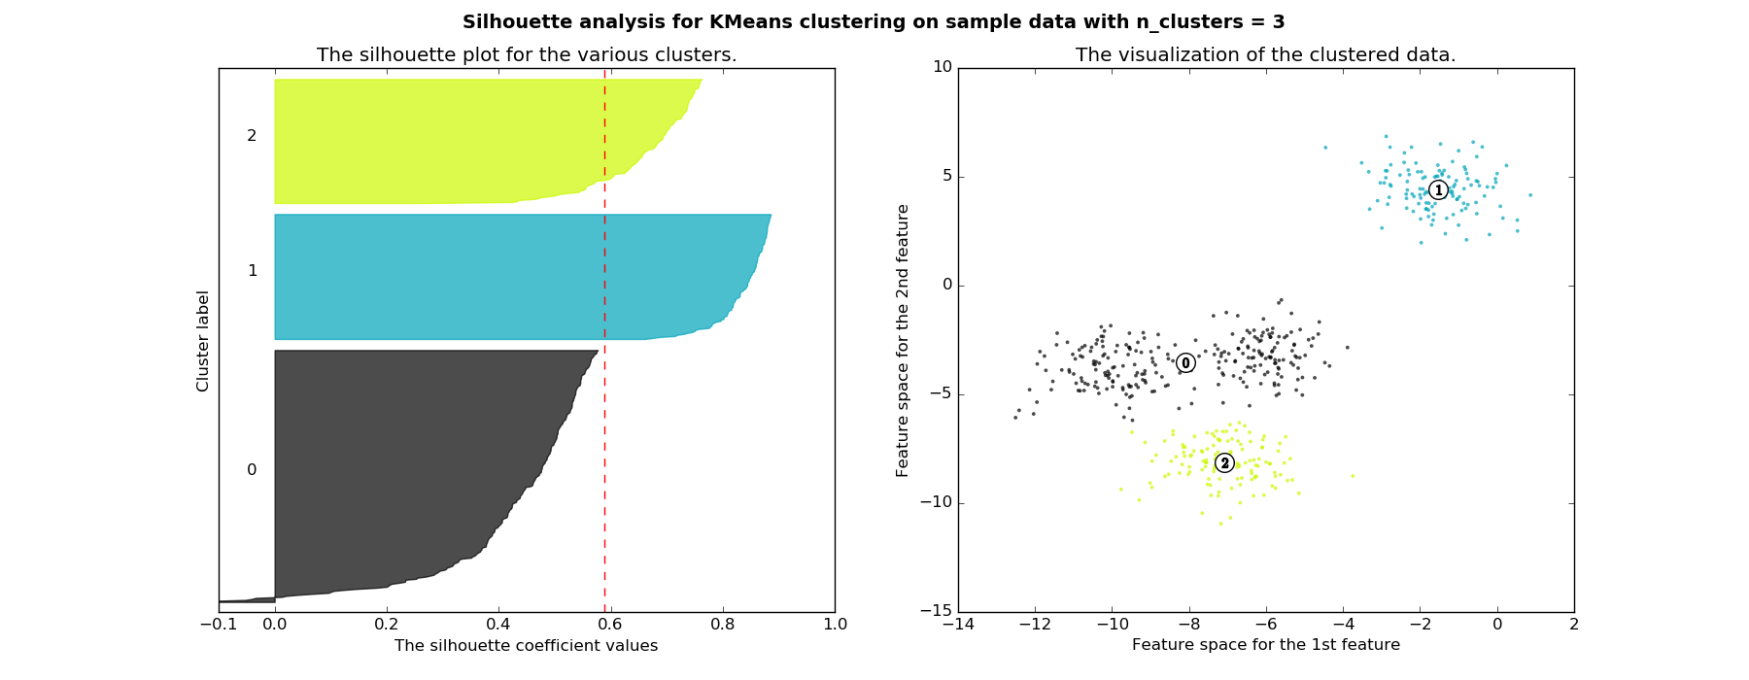
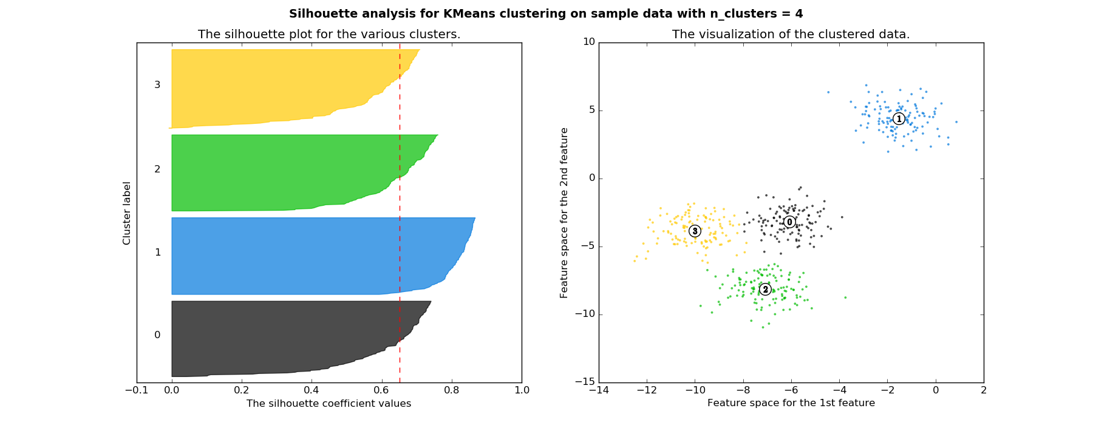
Notes:
Note width is quality of cluster, height is size of cluster
Could also use this to visualize quickly and maybe equal size clusters are important, etc.
Note for top cluster 0, the bottom points might be better included in cluster 2, thus there negative s scores. Cluster 0 not too happy
Whereas all clusters pretty good for k=4 and better overall score
Data would be impossible to see in greater dimensions, but silhouette still easy to visualize

Slide 38
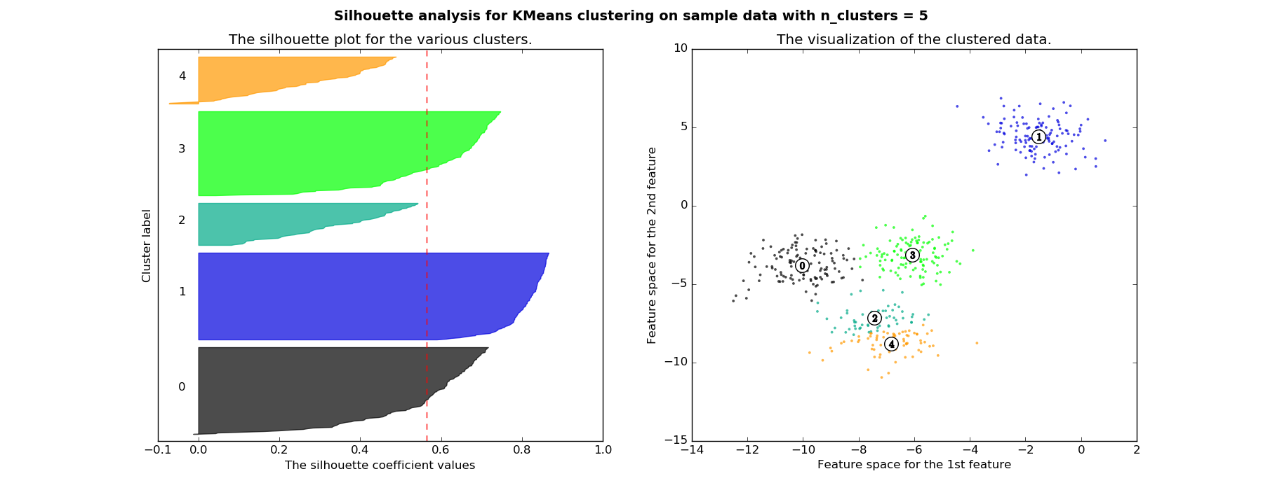
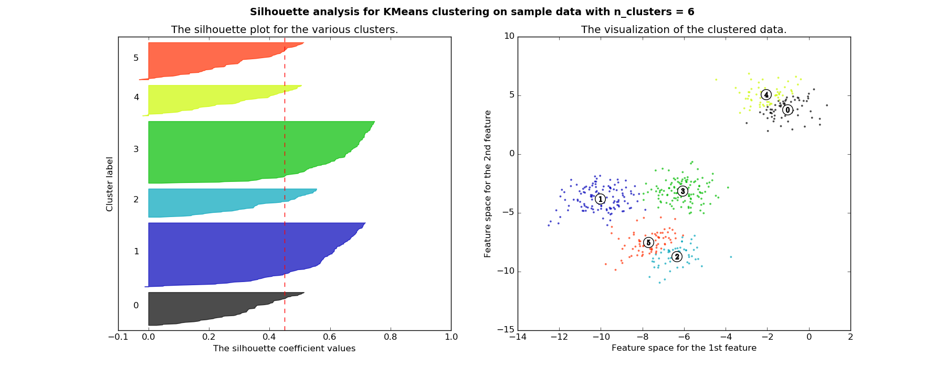
Notes:
Go back and argue which are best: k=2 and k=4. Choose two if just want best score, choose 4 if want fairly equal cluster size. Others are all worse,
Top clusters 4 and 2 are now losers

Slide 39
Silhouette
Clusters are wide – Scores close to 1
Not many small silhouette instances
Depending on your goals:
Clusters are similar in size
Cluster size and/or number are close to what you want
Notes:
Best case silhouette close to 1 (wide) but also having cluster sizes and number close to what you want. Not many small silhouette instances.
If two clusters are equidistant from i, then the one with the highest scatter (the worst case) will maximize ri. It will have typically higher scatter because of the larger squared distances from the centroid.
What might a plot of DB vs k look like?

Slide 40
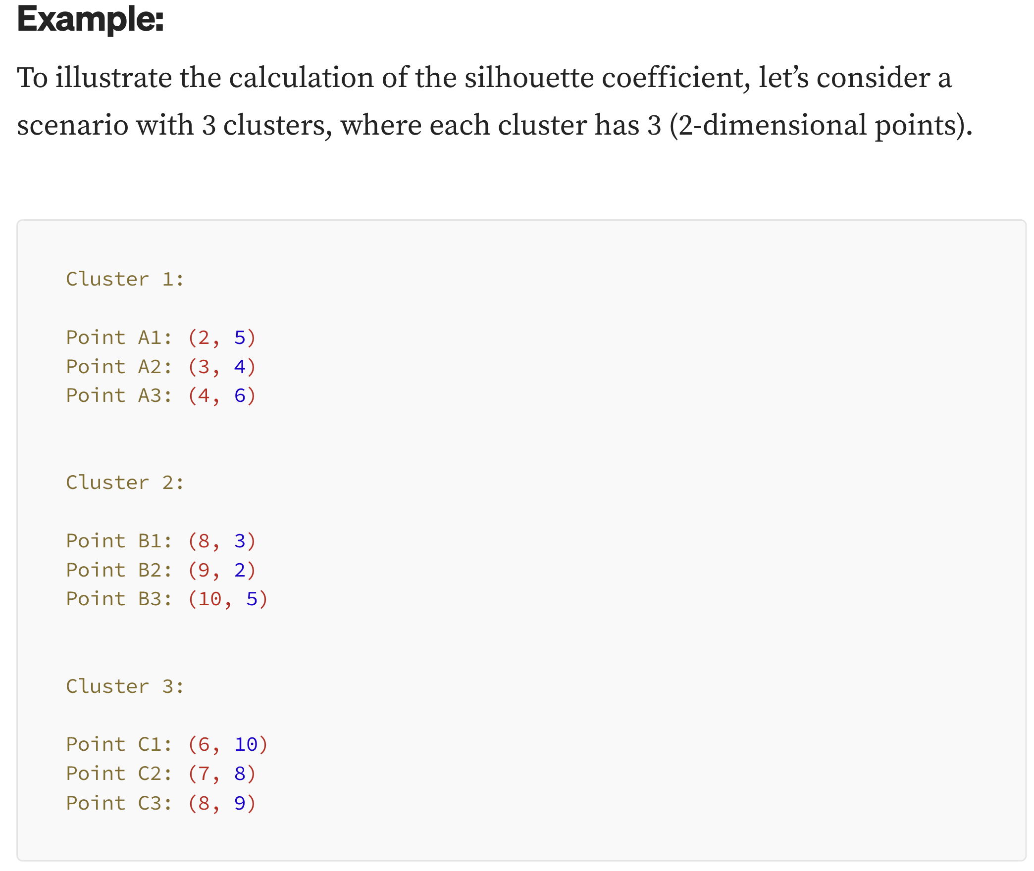

Slide 41
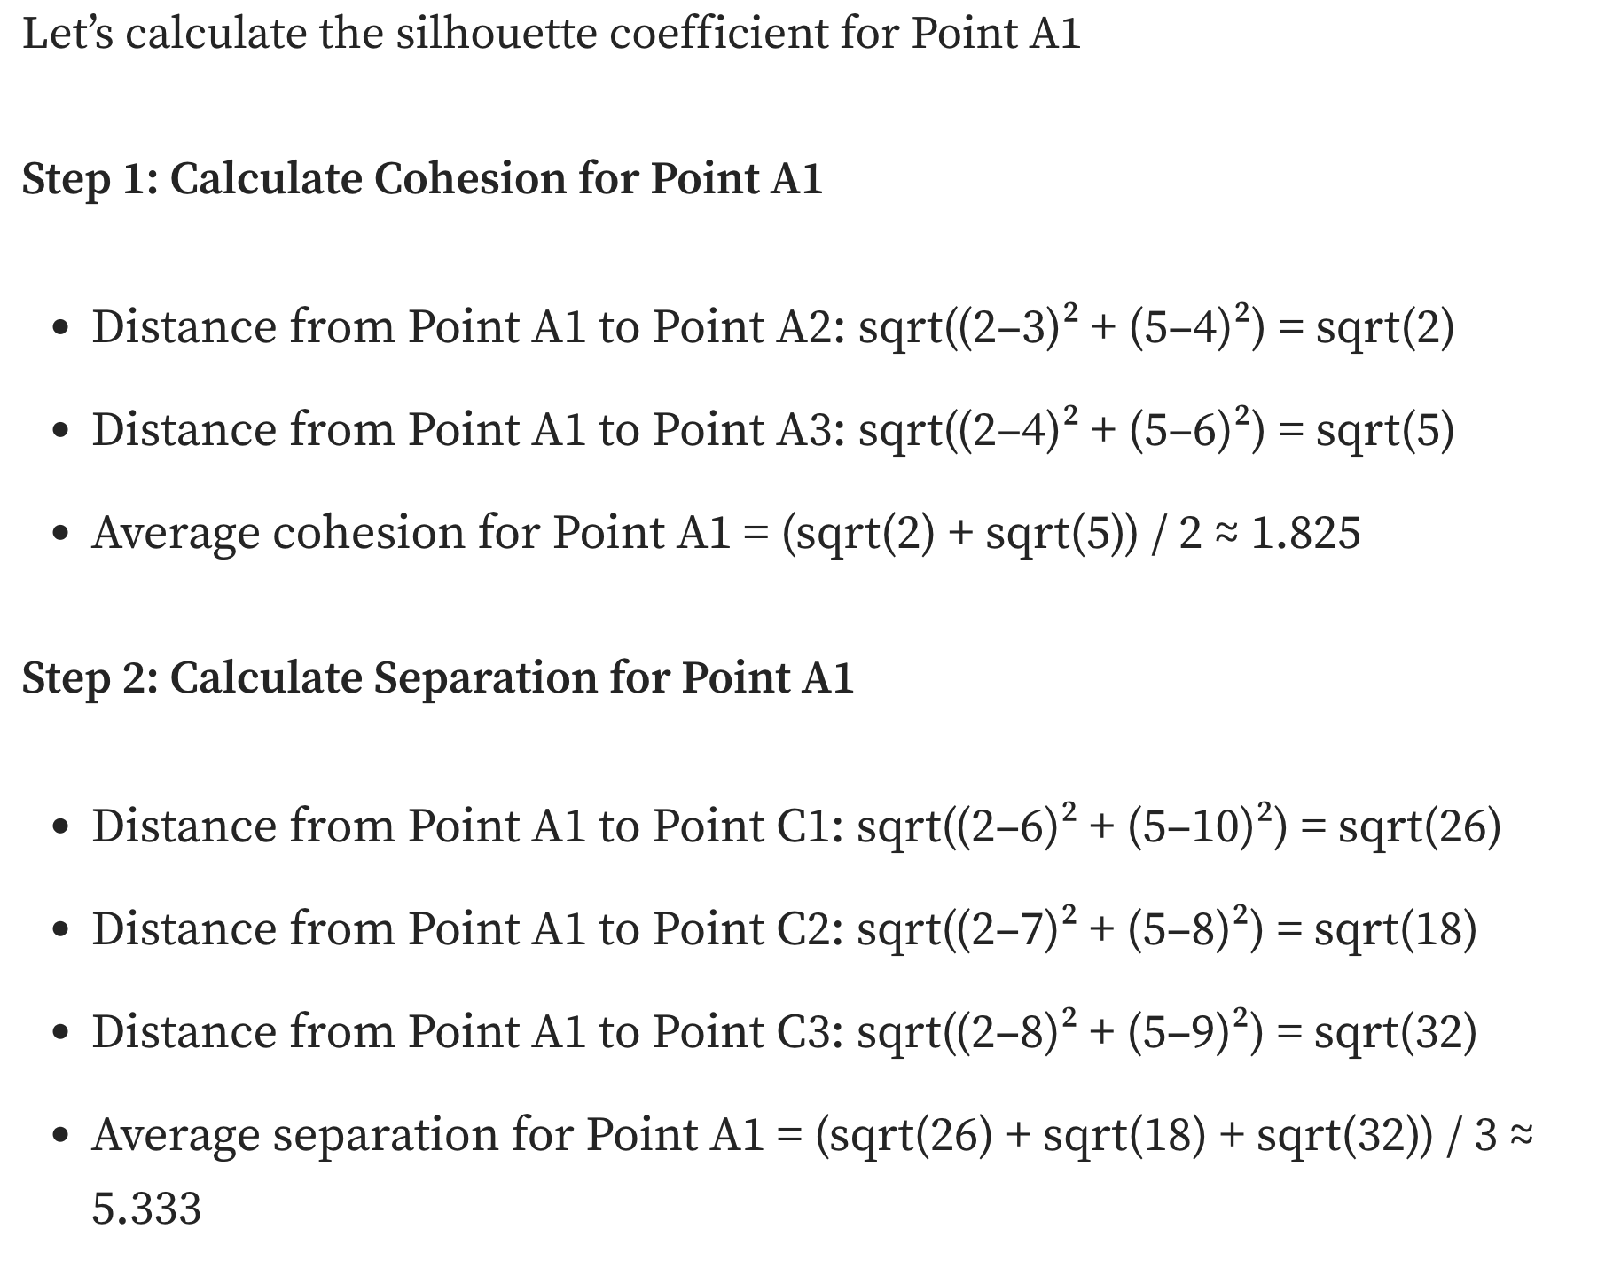

Slide 42
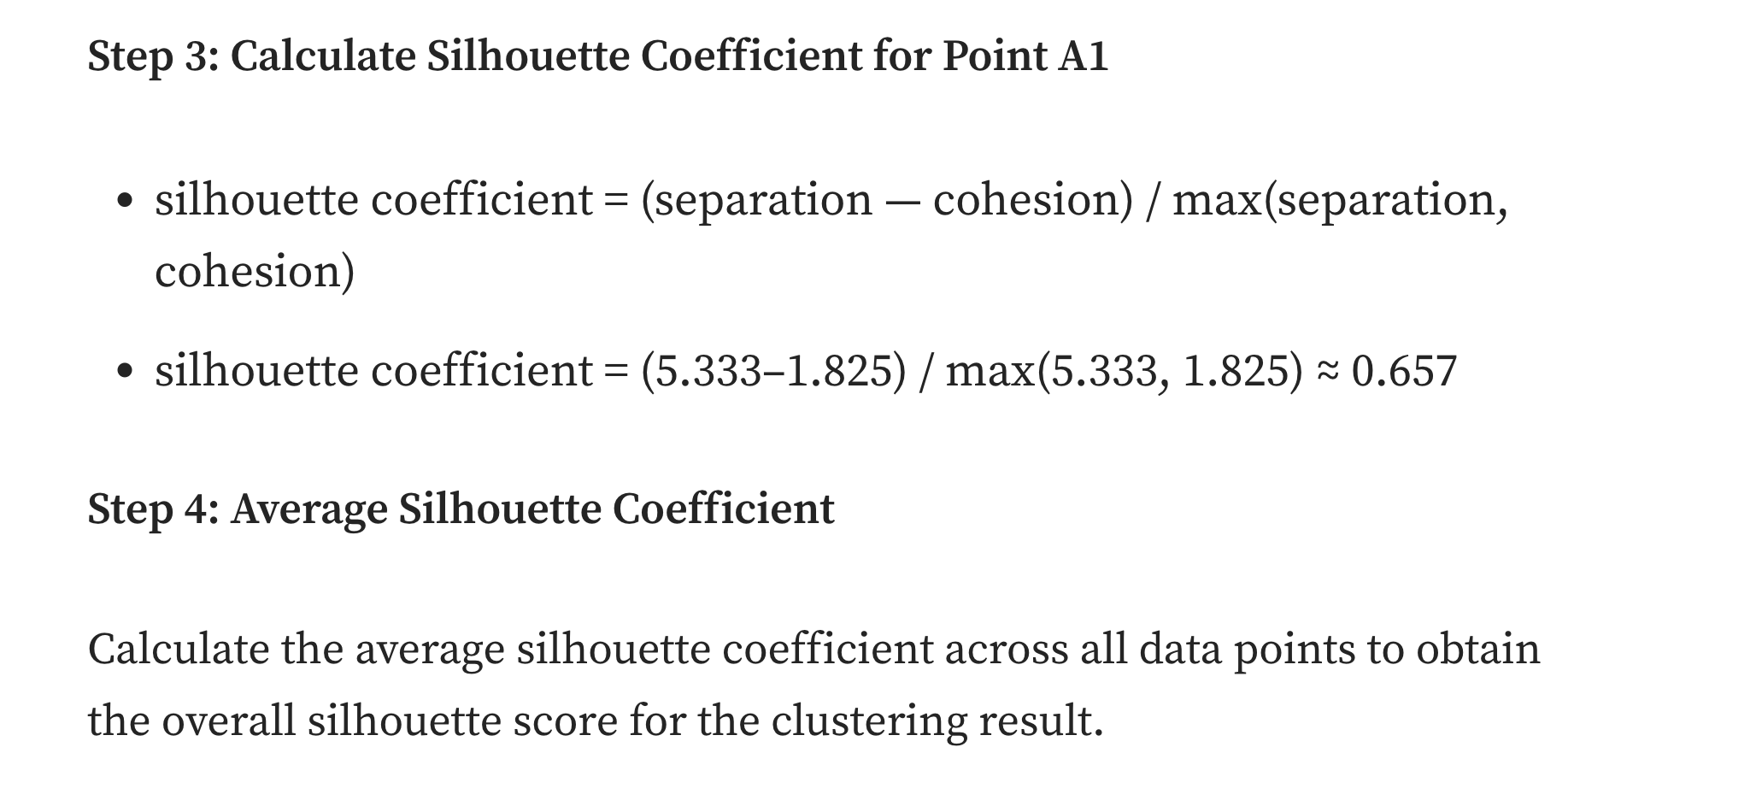

Slide 43
Silhouette
Could just use total silhouette average to decide best clustering but best to do silhouette analysis with a visualization tool and use score along with other aspects of the clustering
Cluster sizes
Number of clusters
Shape of clusters
Etc.
Note when task dimensions are > 3 (typical and no longer visualizable for us), silhouette graph still easy to visualize
O(n²) complexity due to b(i) computation
There are other cluster metrics out there
These metrics are rough guidelines and should be "taken with a grain of salt"
Notes:
Best case silhouette close to 1 (wide) but also having cluster sizes and number close to what you want. Not many small silhouette instances.
If two clusters are equidistant from i, then the one with the highest scatter (the worst case) will maximize ri. It will have typically higher scatter because of the larger squared distances from the centroid.
What might a plot of DB vs k look like?

Slide 44
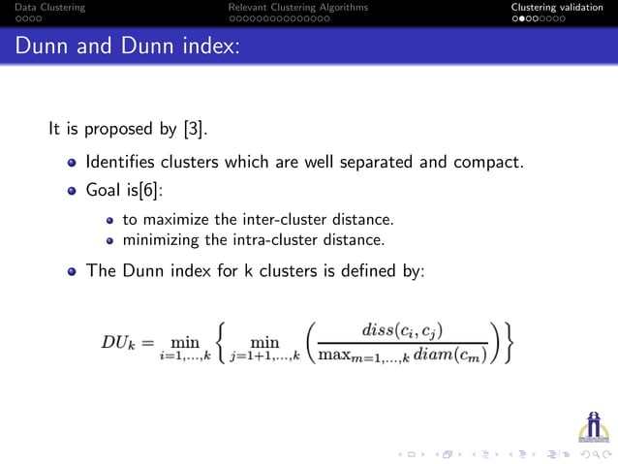

Slide 45
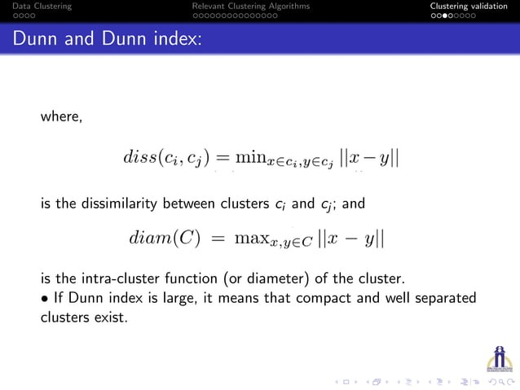

Slide 46
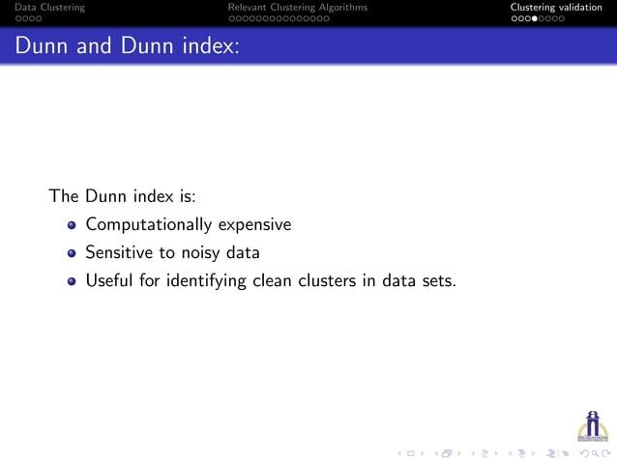

Slide 47
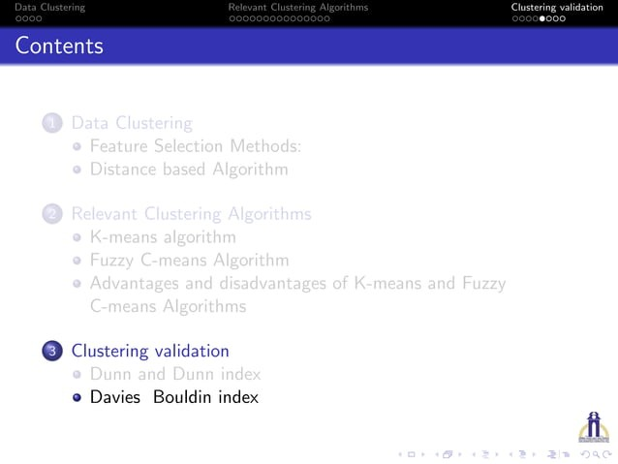

Slide 48
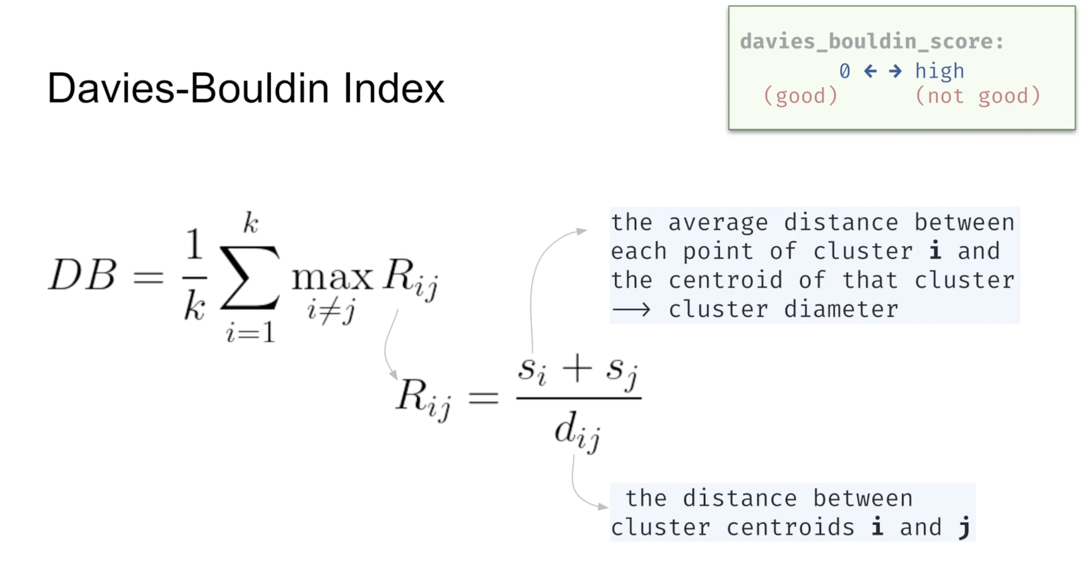

Slide 49
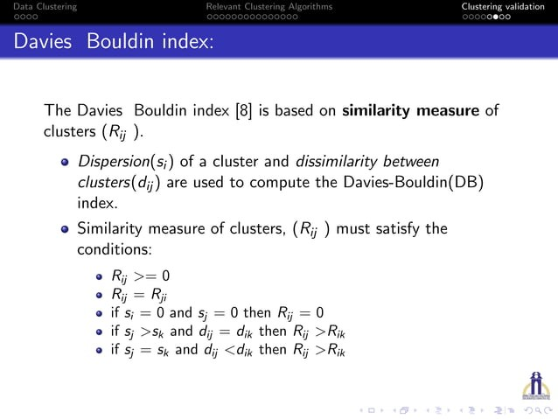

Slide 50
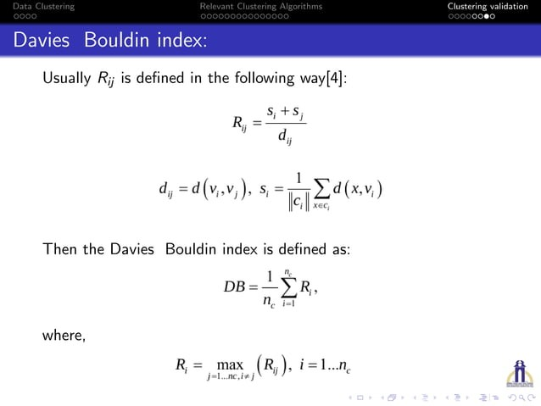

Slide 51
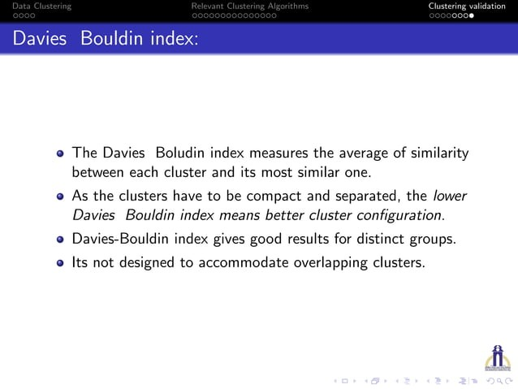

Slide 52
Rand Index
Y={(a,b,c), (d,e,f)} Y'={(a,b), (c,d,e), (f)}
 | ab | ac | ad | ae | af | bc | bd | be | bf | cd | ce | cf | de | df | ef | Total
together in both | * |  |  |  |  |  |  |  |  |  |  |  | * |  |  | 2
separate in both |  |  | * | * | * |  | * | * | * |  |  | * |  |  |  | 7
discordant |  | * |  |  |  | * |  |  |  | * | * |  |  | * | * | 6
Rand index: c(Y, Y') =(2+7)/15=0.6 (percentage of concordance)
1≥ c(Y, Y')≥0
Clustering methods can be evaluated by c(Y, Y_{truth}) if Y_{truth} available.

Slide 53
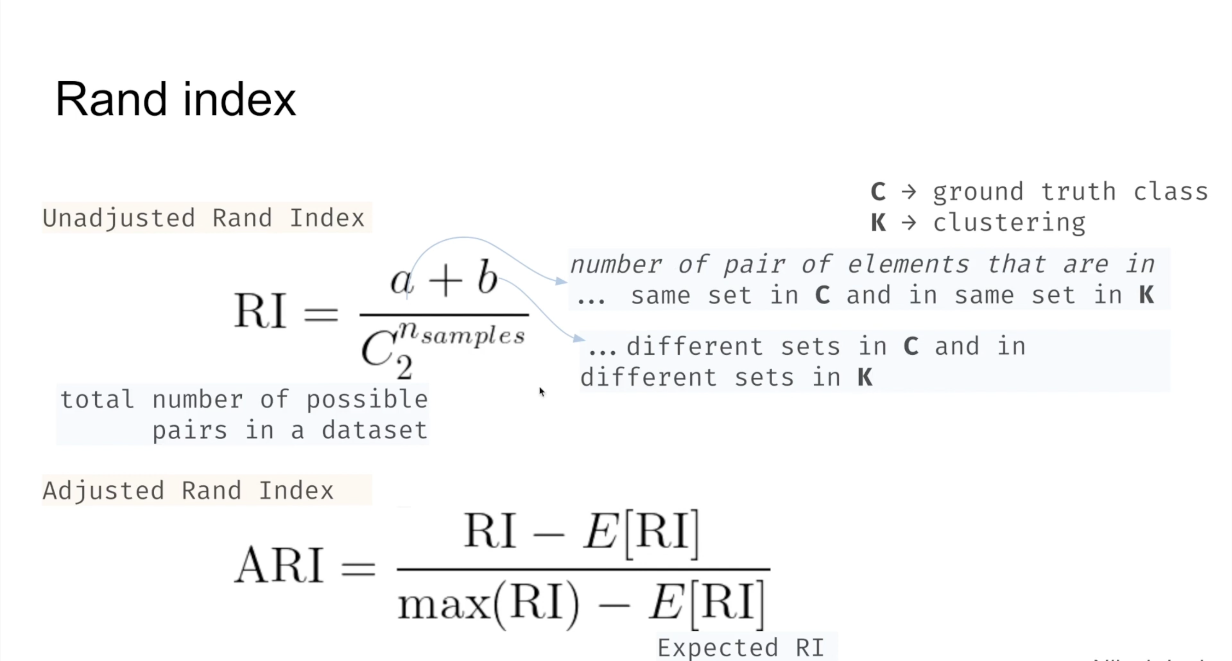

Slide 54
The Adjusted Rand Index (ARI) is a measure of the similarity between two data clusterings.
It is a correction of the Rand Index, which is a basic measure of similarity between two clusterings, but it has the disadvantage of being sensitive to chance.
The Adjusted Rand Index takes into account the fact that some agreement between two clusterings can occur by chance, and it adjusts the Rand Index to account for this possibility.

Slide 55
It is calculated as follows:
Let N be the number of samples in the data set.
2. Let C1 and C2 be two different clusterings of the data set.
3. Let a be the number of pairs of samples that are in the same cluster in both C1 and C2.
4. Let b be the number of pairs of samples that are in different clusters in C1 and C2.
5. Calculate the Rand Index RI as RI = (a + b) / (N choose 2), where (N choose 2) is the number of possible pairs of samples.
6. Calculate the expected value E of the Rand Index for random clusterings, given by: E = (sum(n_i choose 2) * sum(n_j choose 2)) / (N choose 2), where n_i is the number of samples in cluster i and n_j is the number of samples in cluster j.
7. Calculate the Adjusted Rand Index ARI as ARI = (RI - E) / (max(RI) - E), where max(RI) = 1.

Slide 56
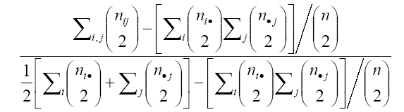
Adjusted Rand index: (Hubert and Arabie 1985)
Adjusted Rand index =
The adjusted Rand index will take maximum value at 1 and constant expected value 0 (when two clusterings are totally independent)

Slide 57
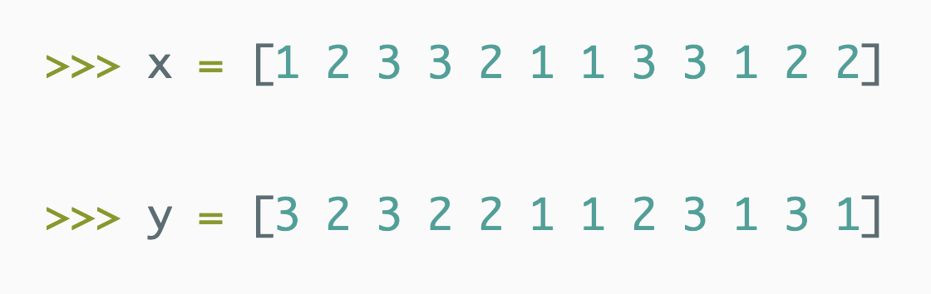
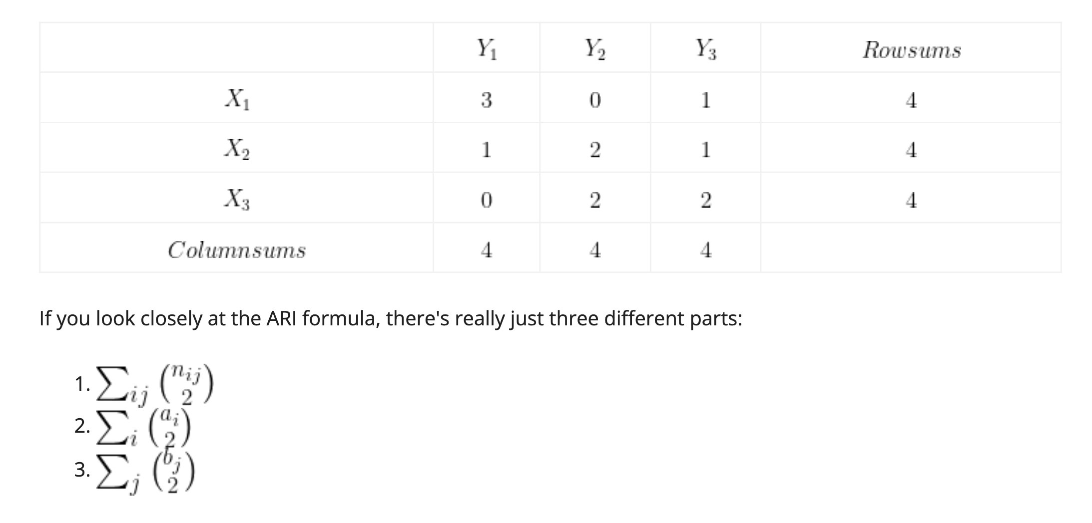

Slide 58
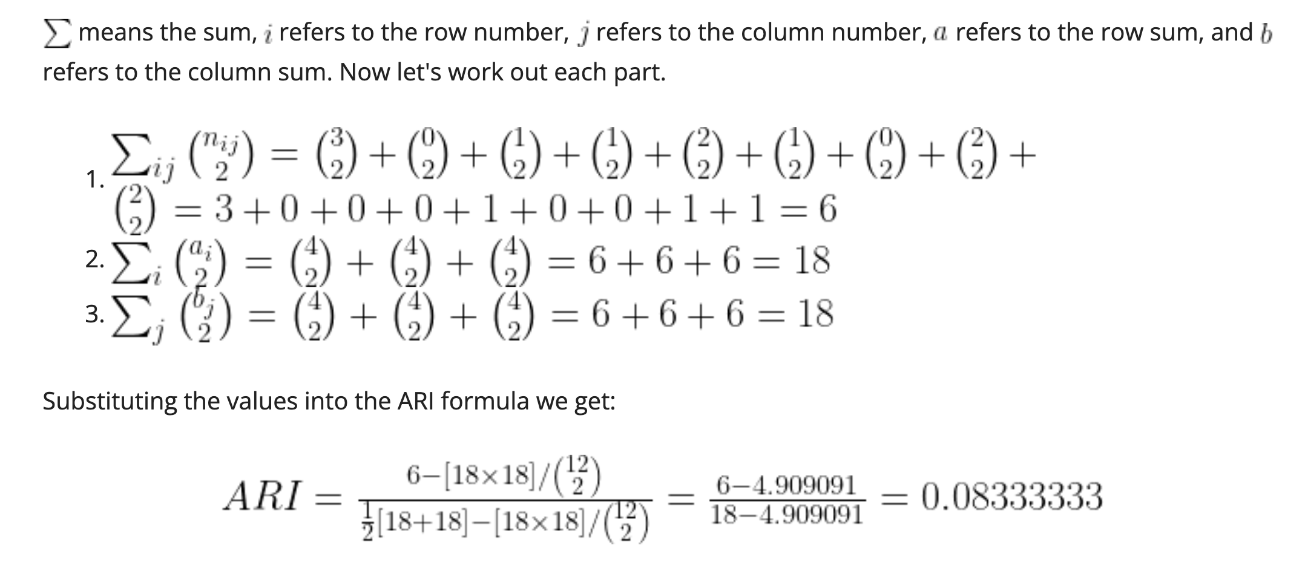

Slide 59
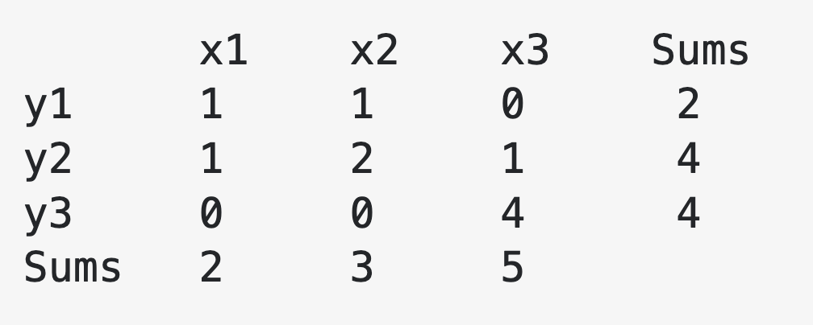

Slide 60
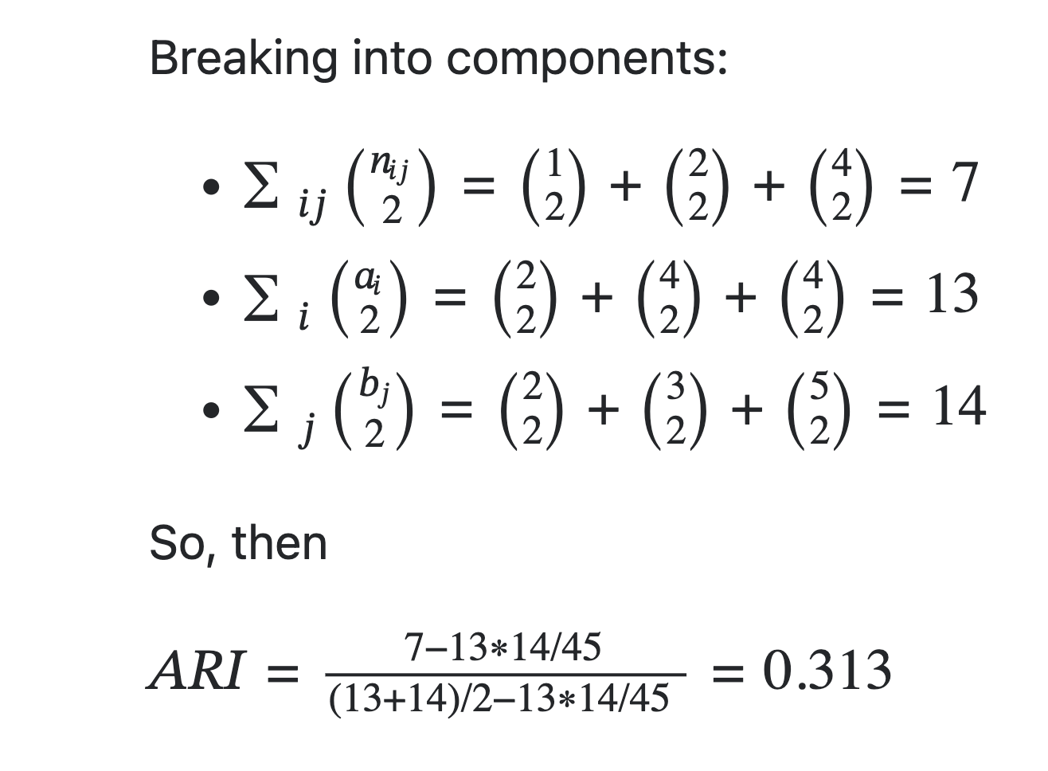

Slide 61
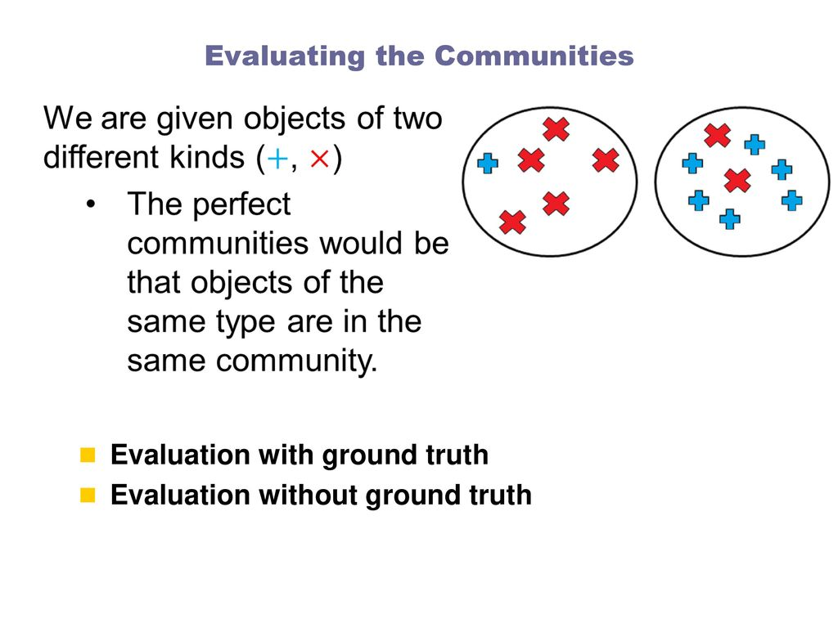

Slide 62
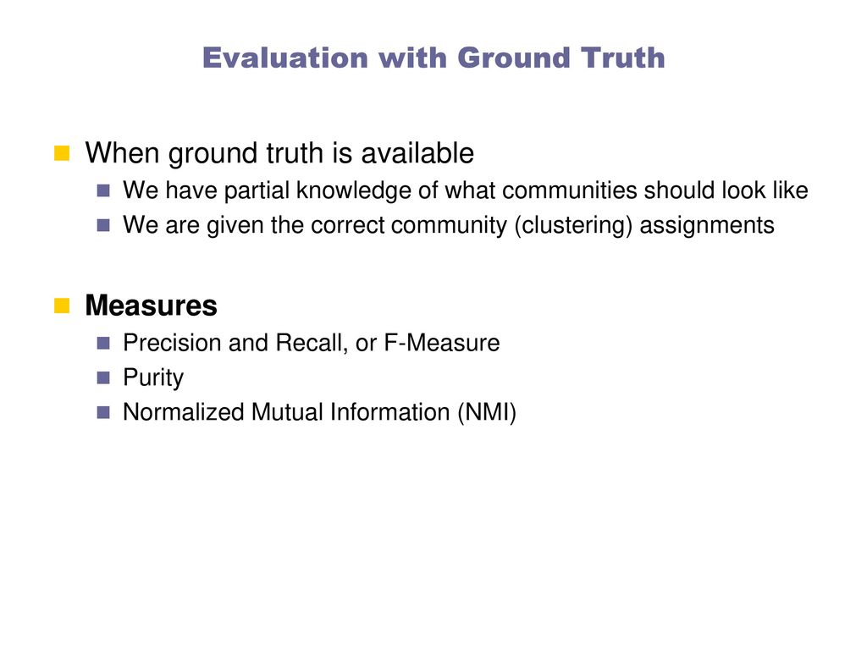

Slide 63
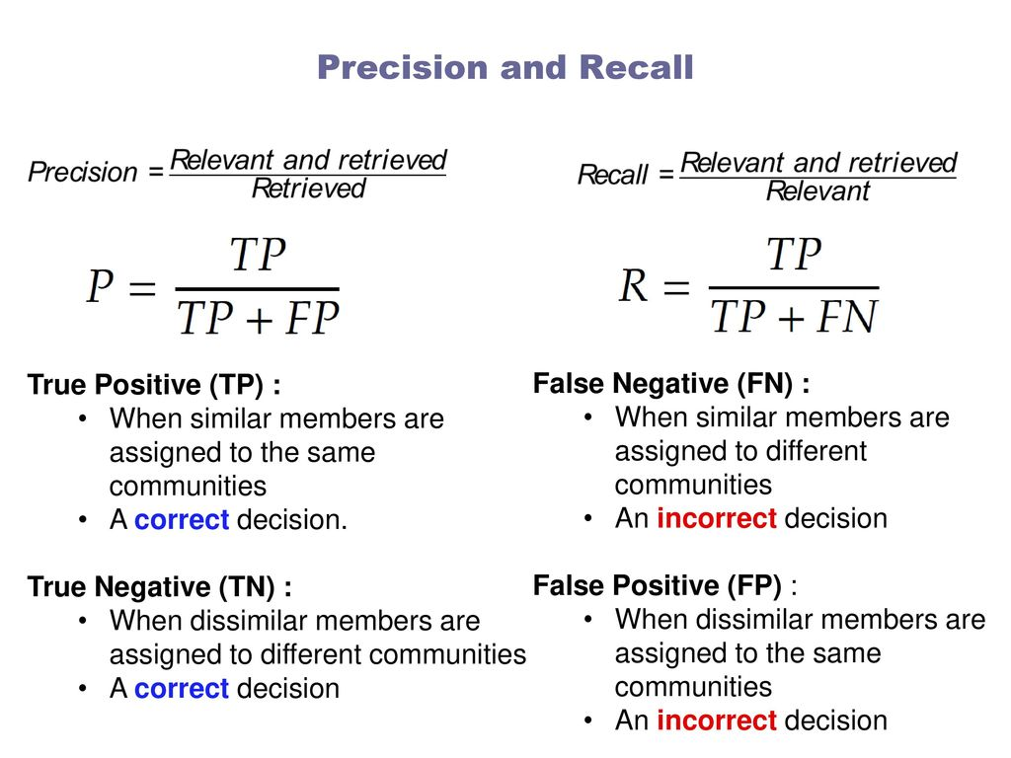

Slide 64
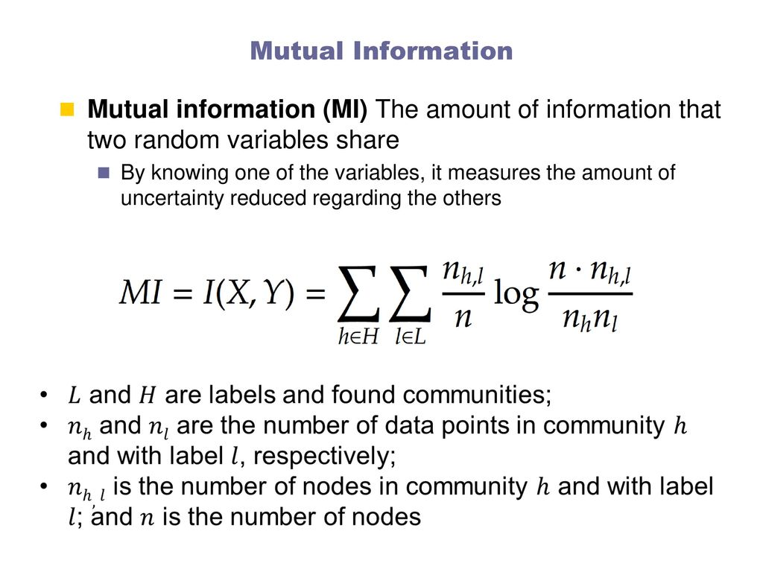

Slide 65
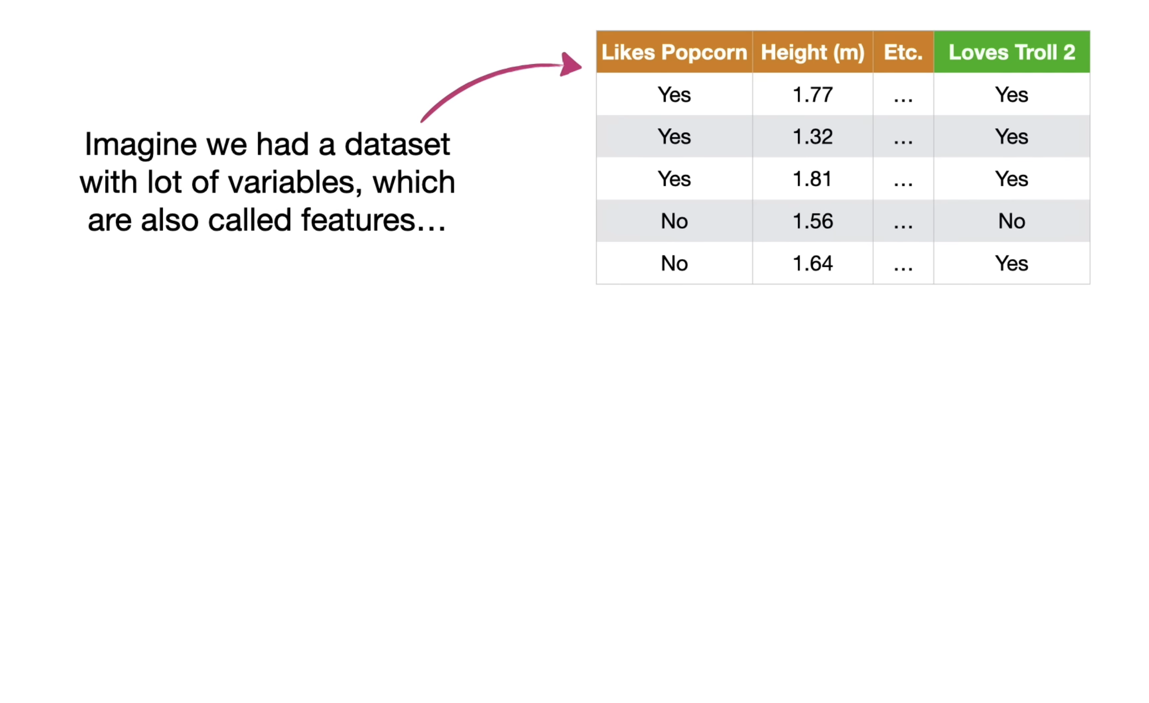

Slide 66
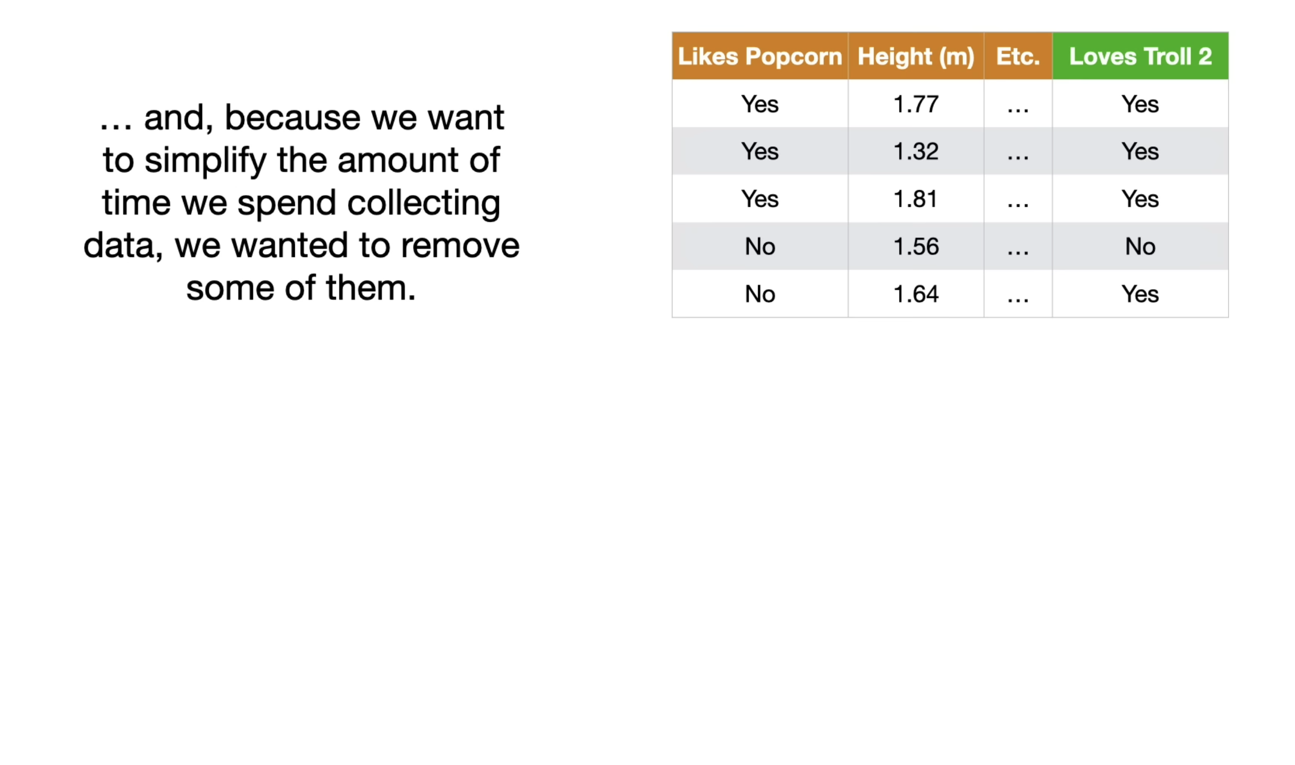

Slide 67
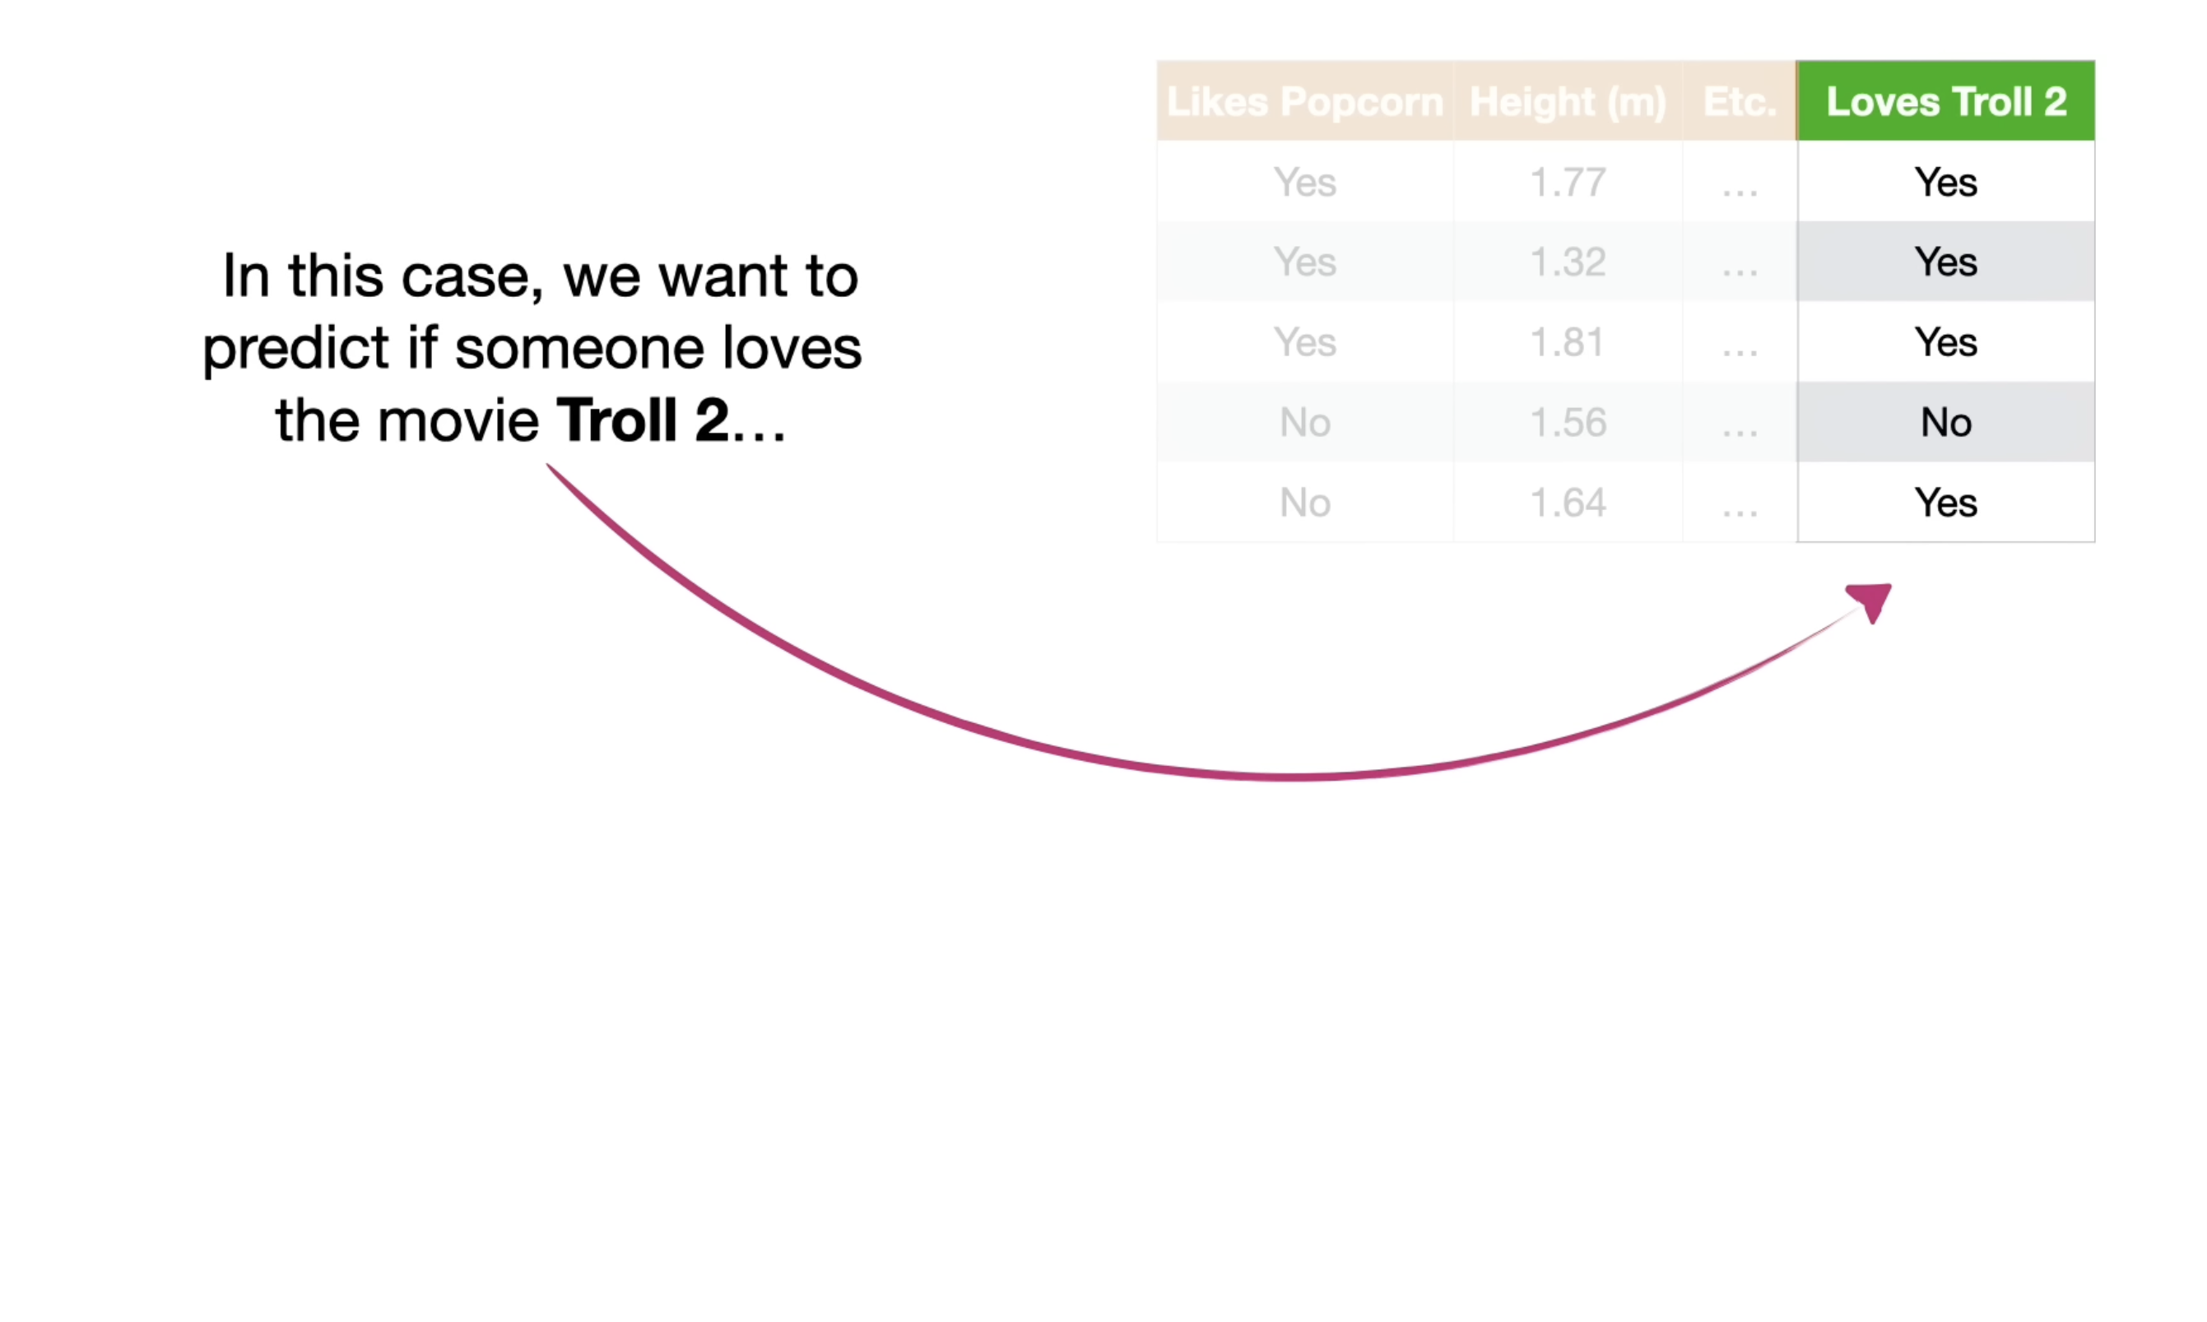

Slide 68
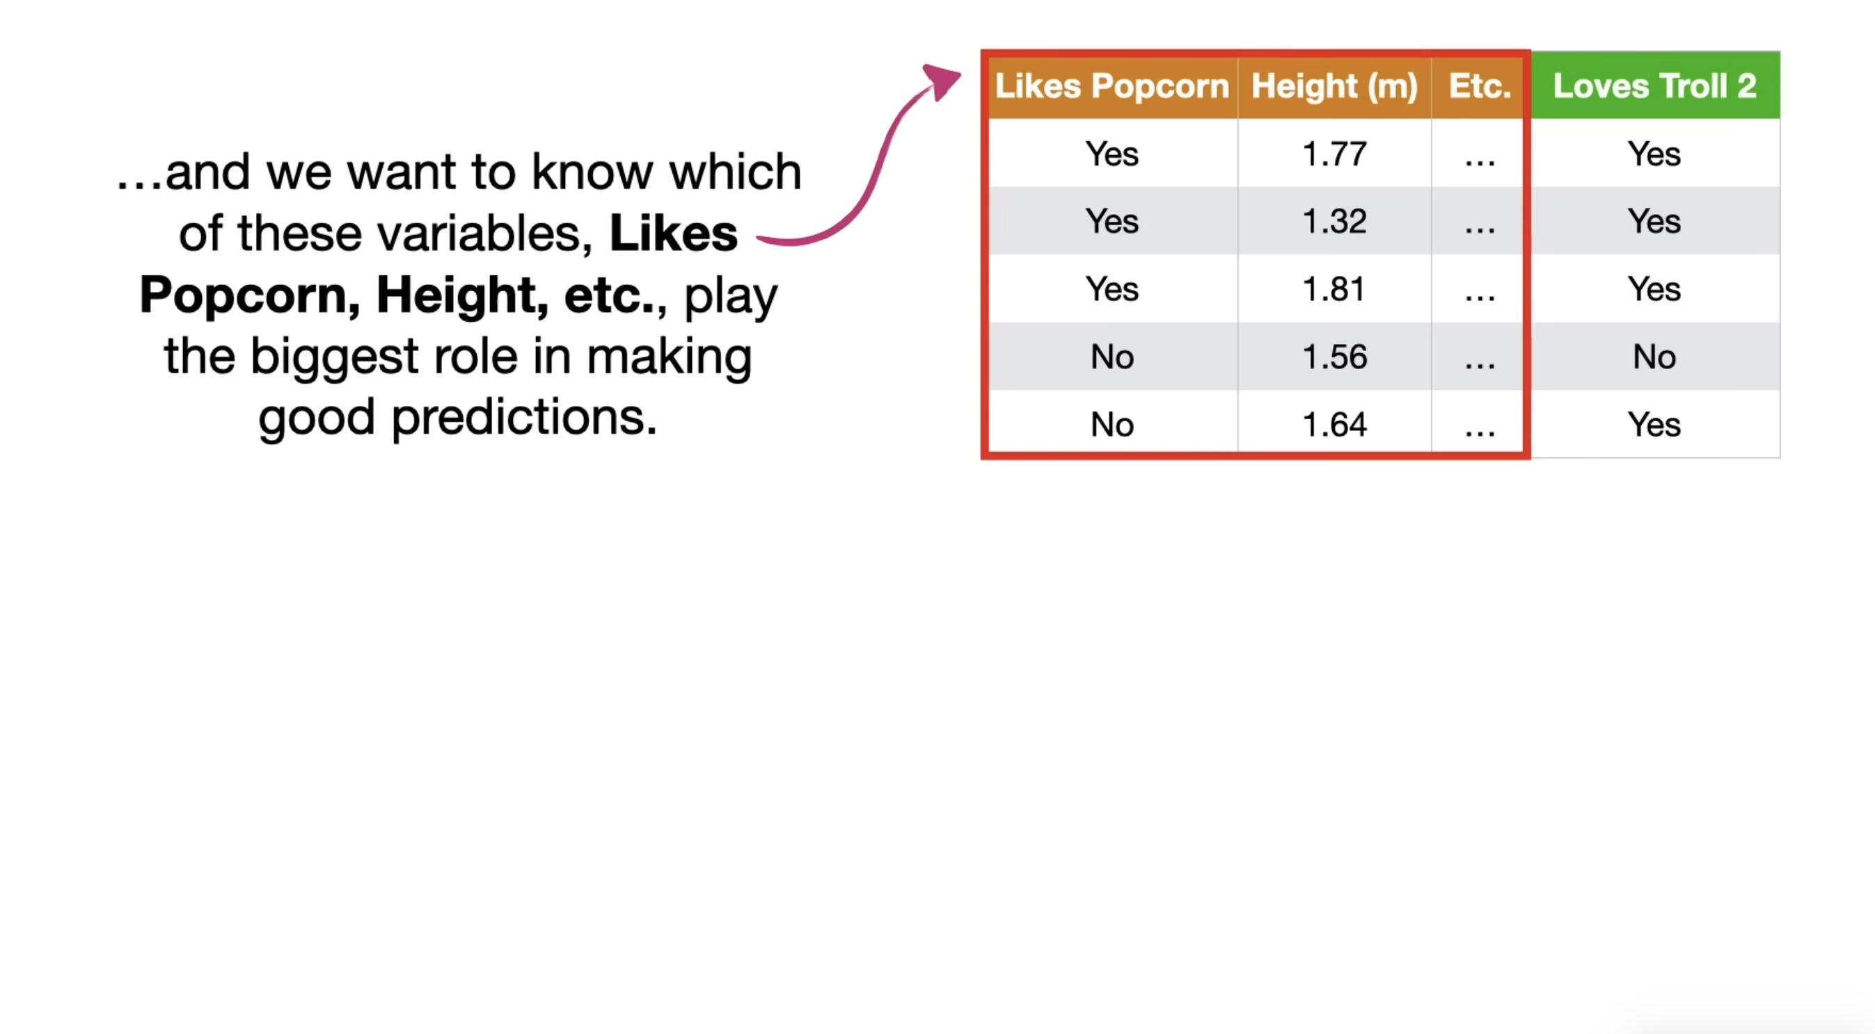

Slide 69
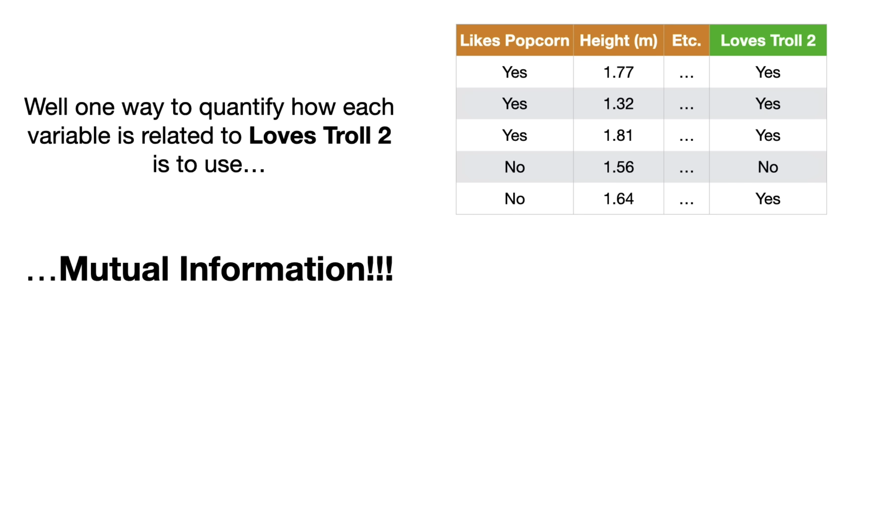

Slide 70
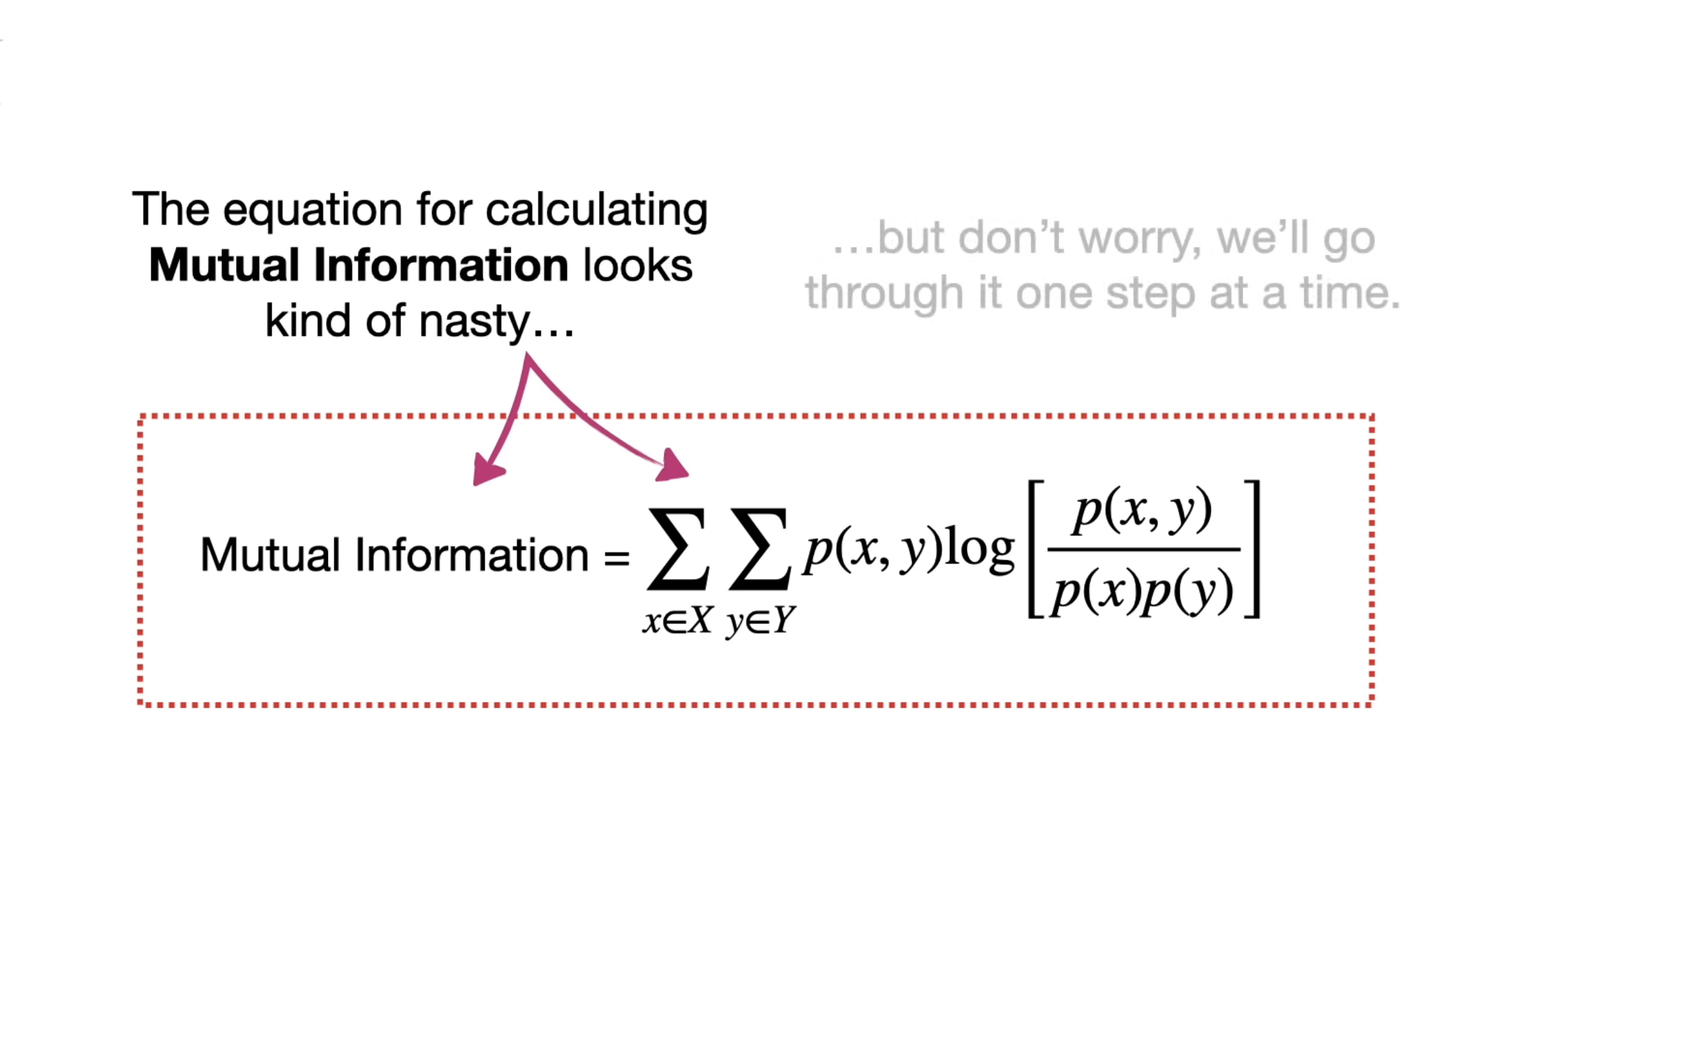

Slide 71
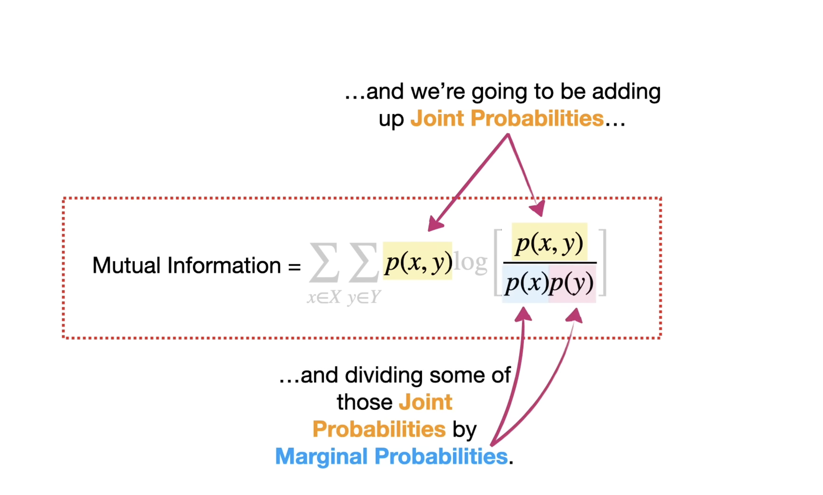

Slide 72
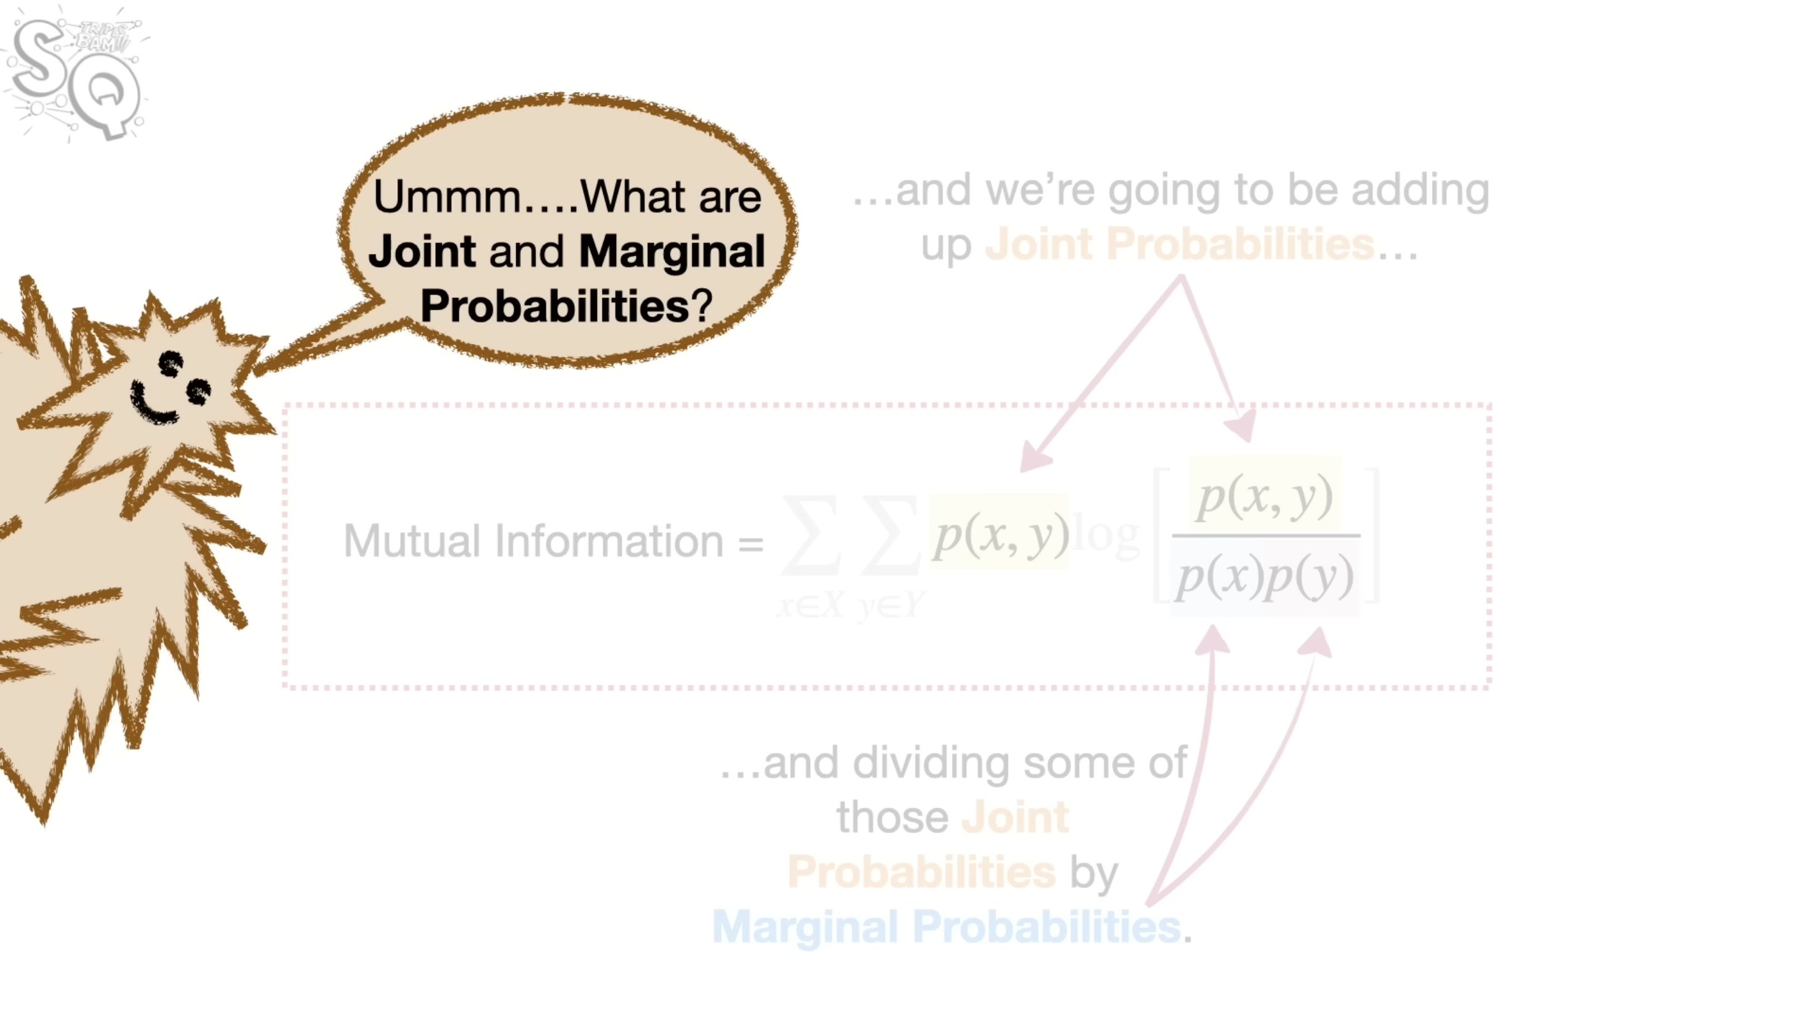

Slide 73
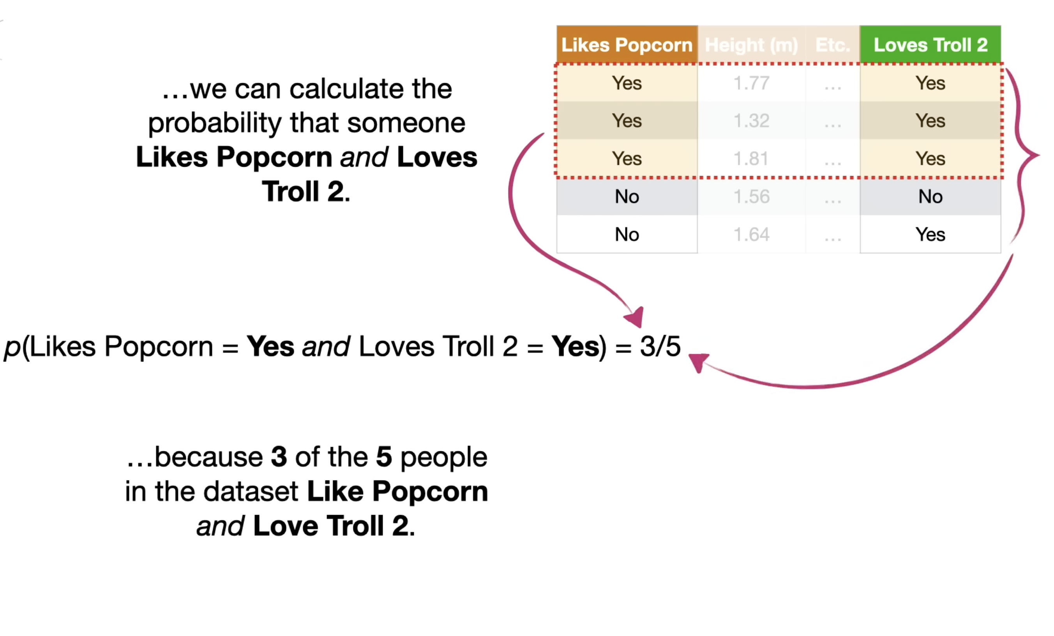

Slide 74
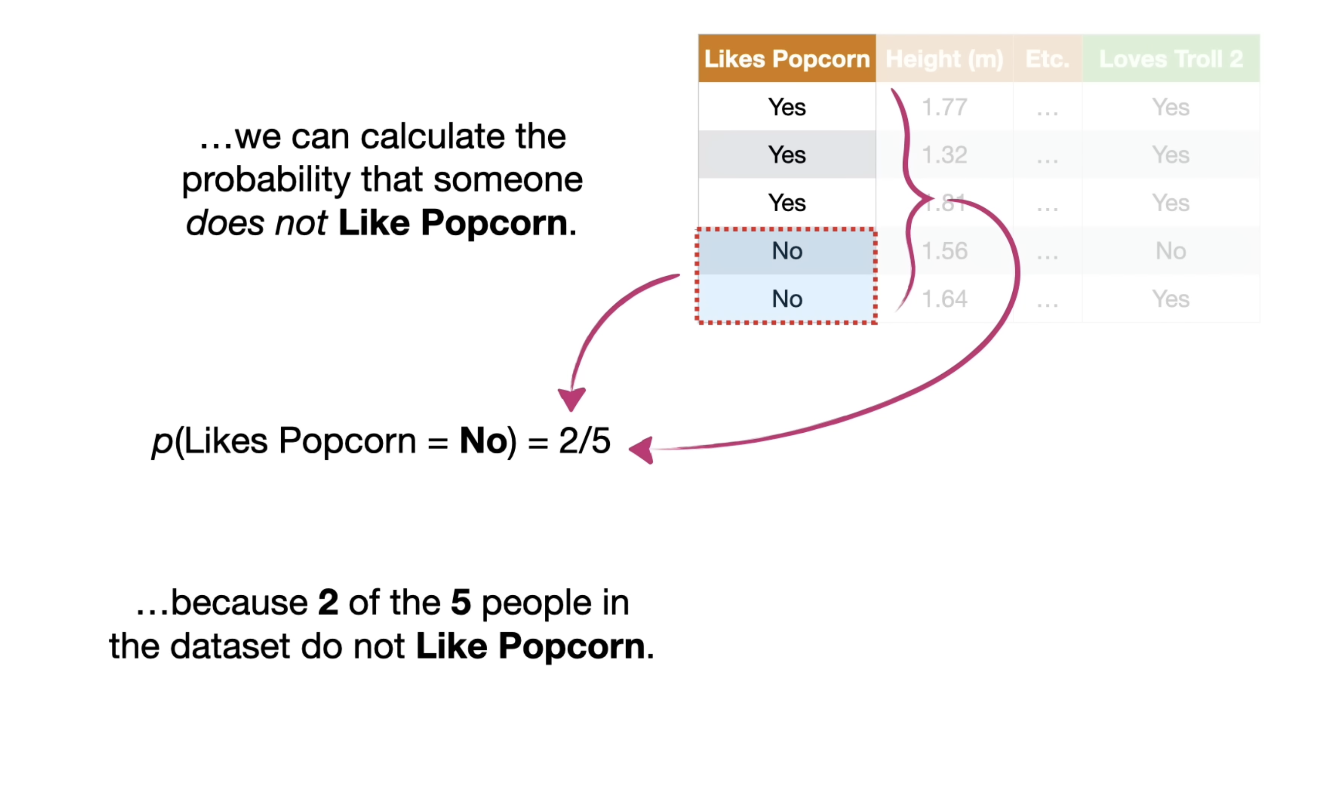

Slide 75
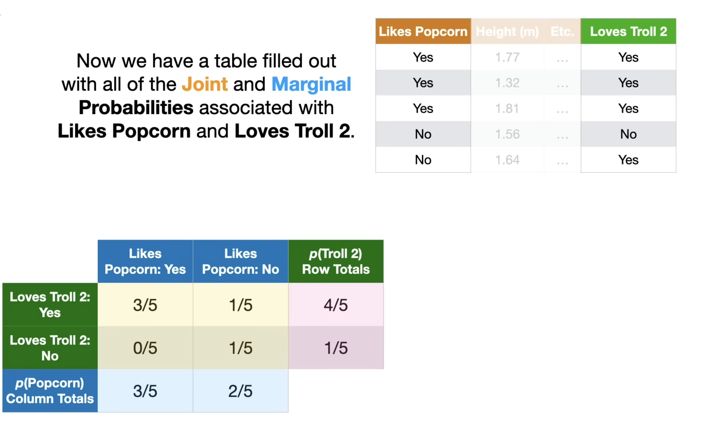

Slide 76
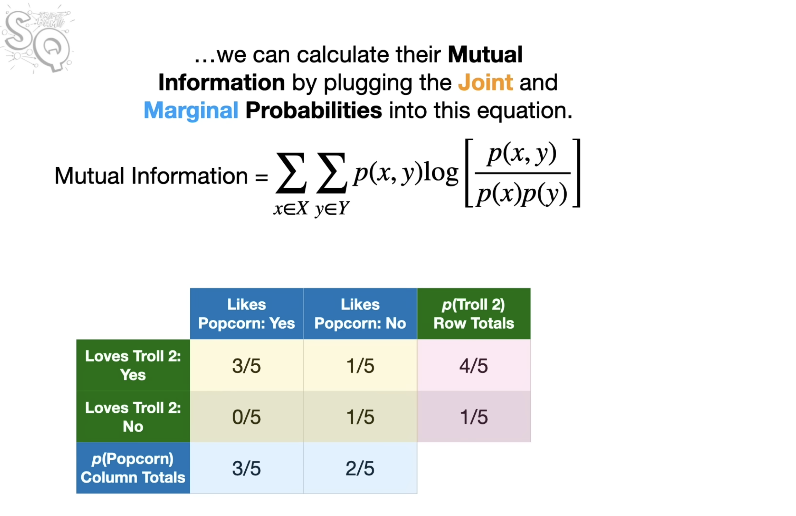

Slide 77
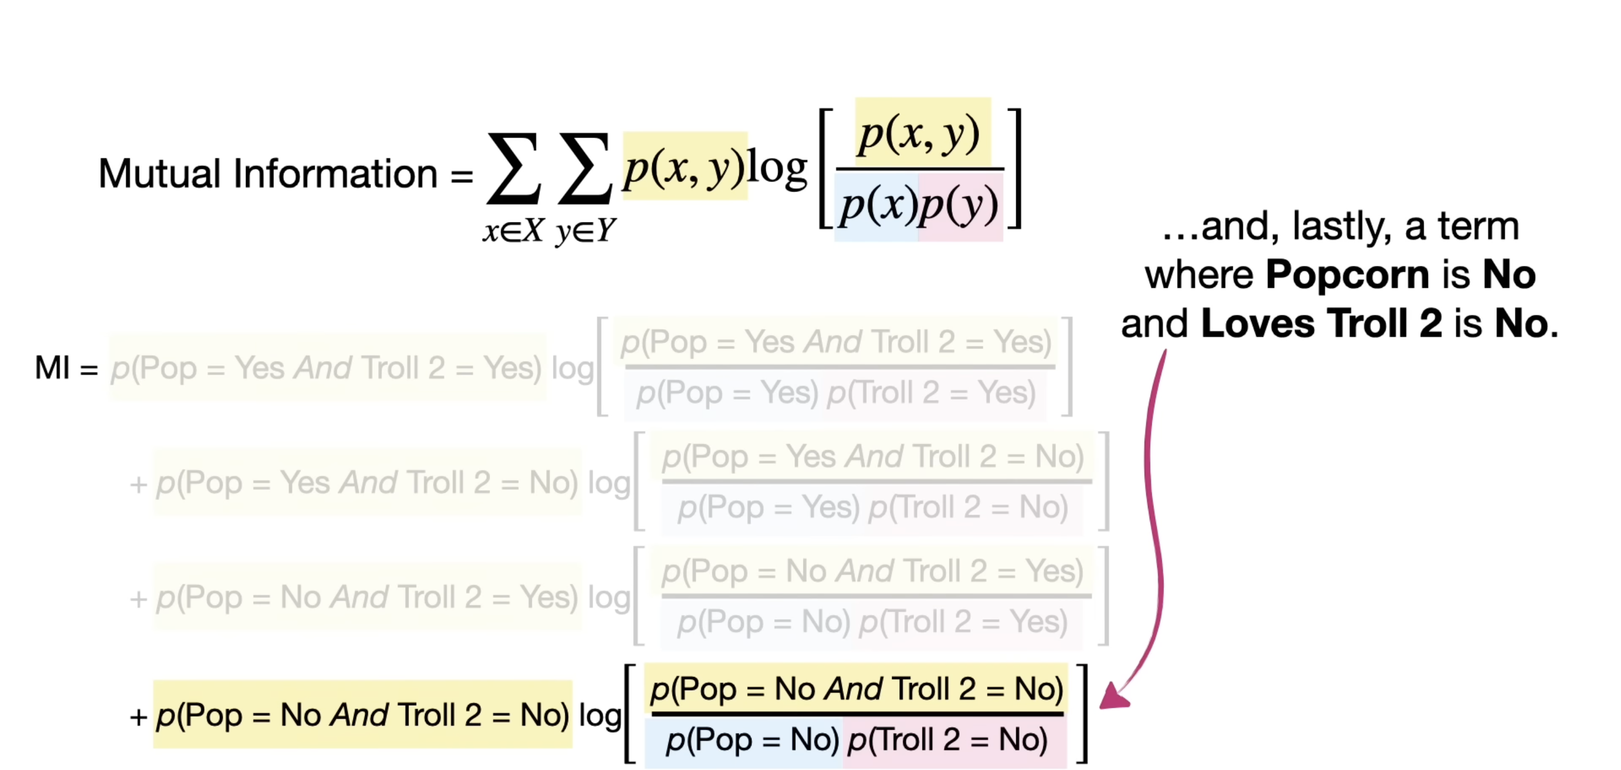

Slide 78
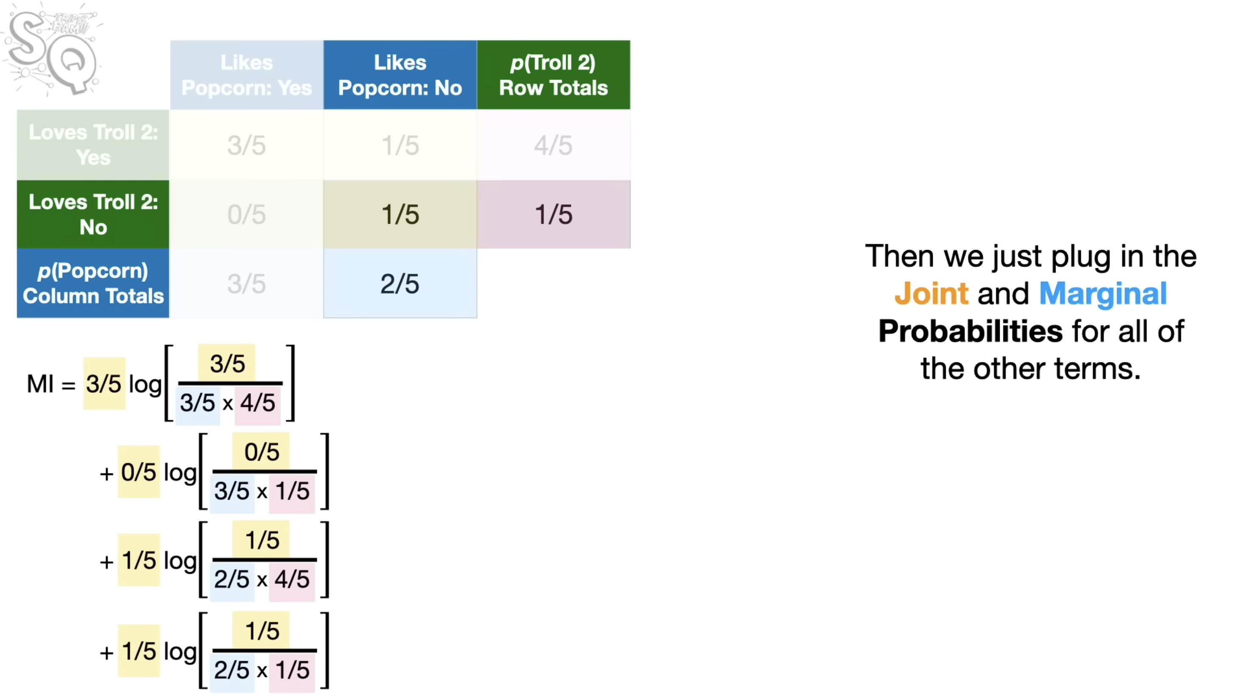

Slide 79
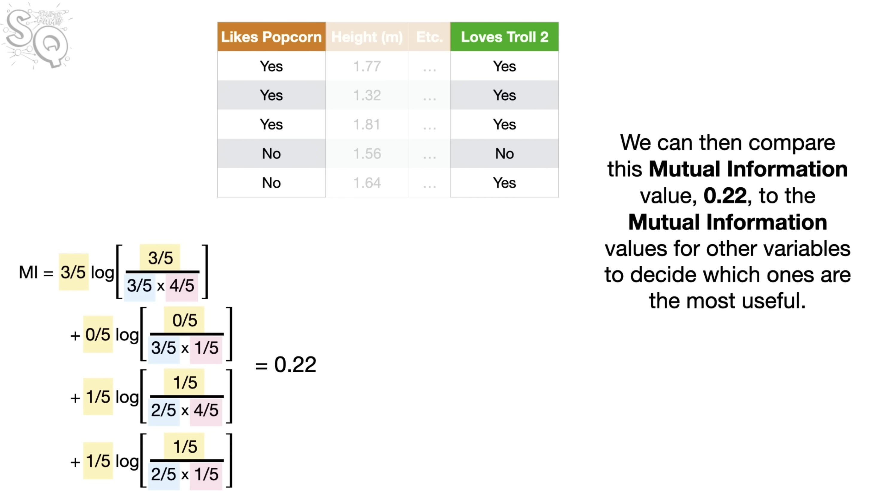

Slide 80
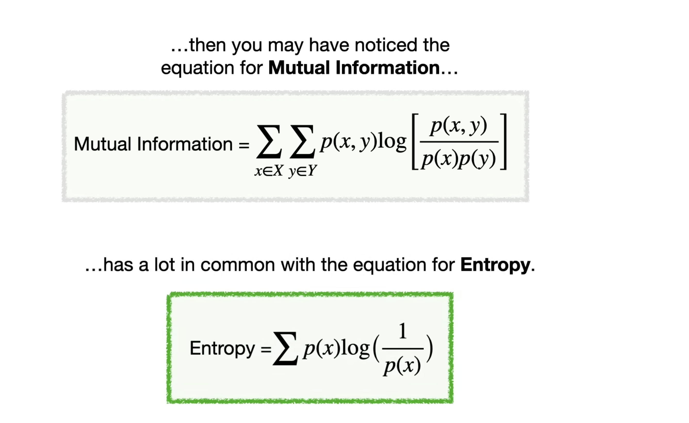

Slide 81
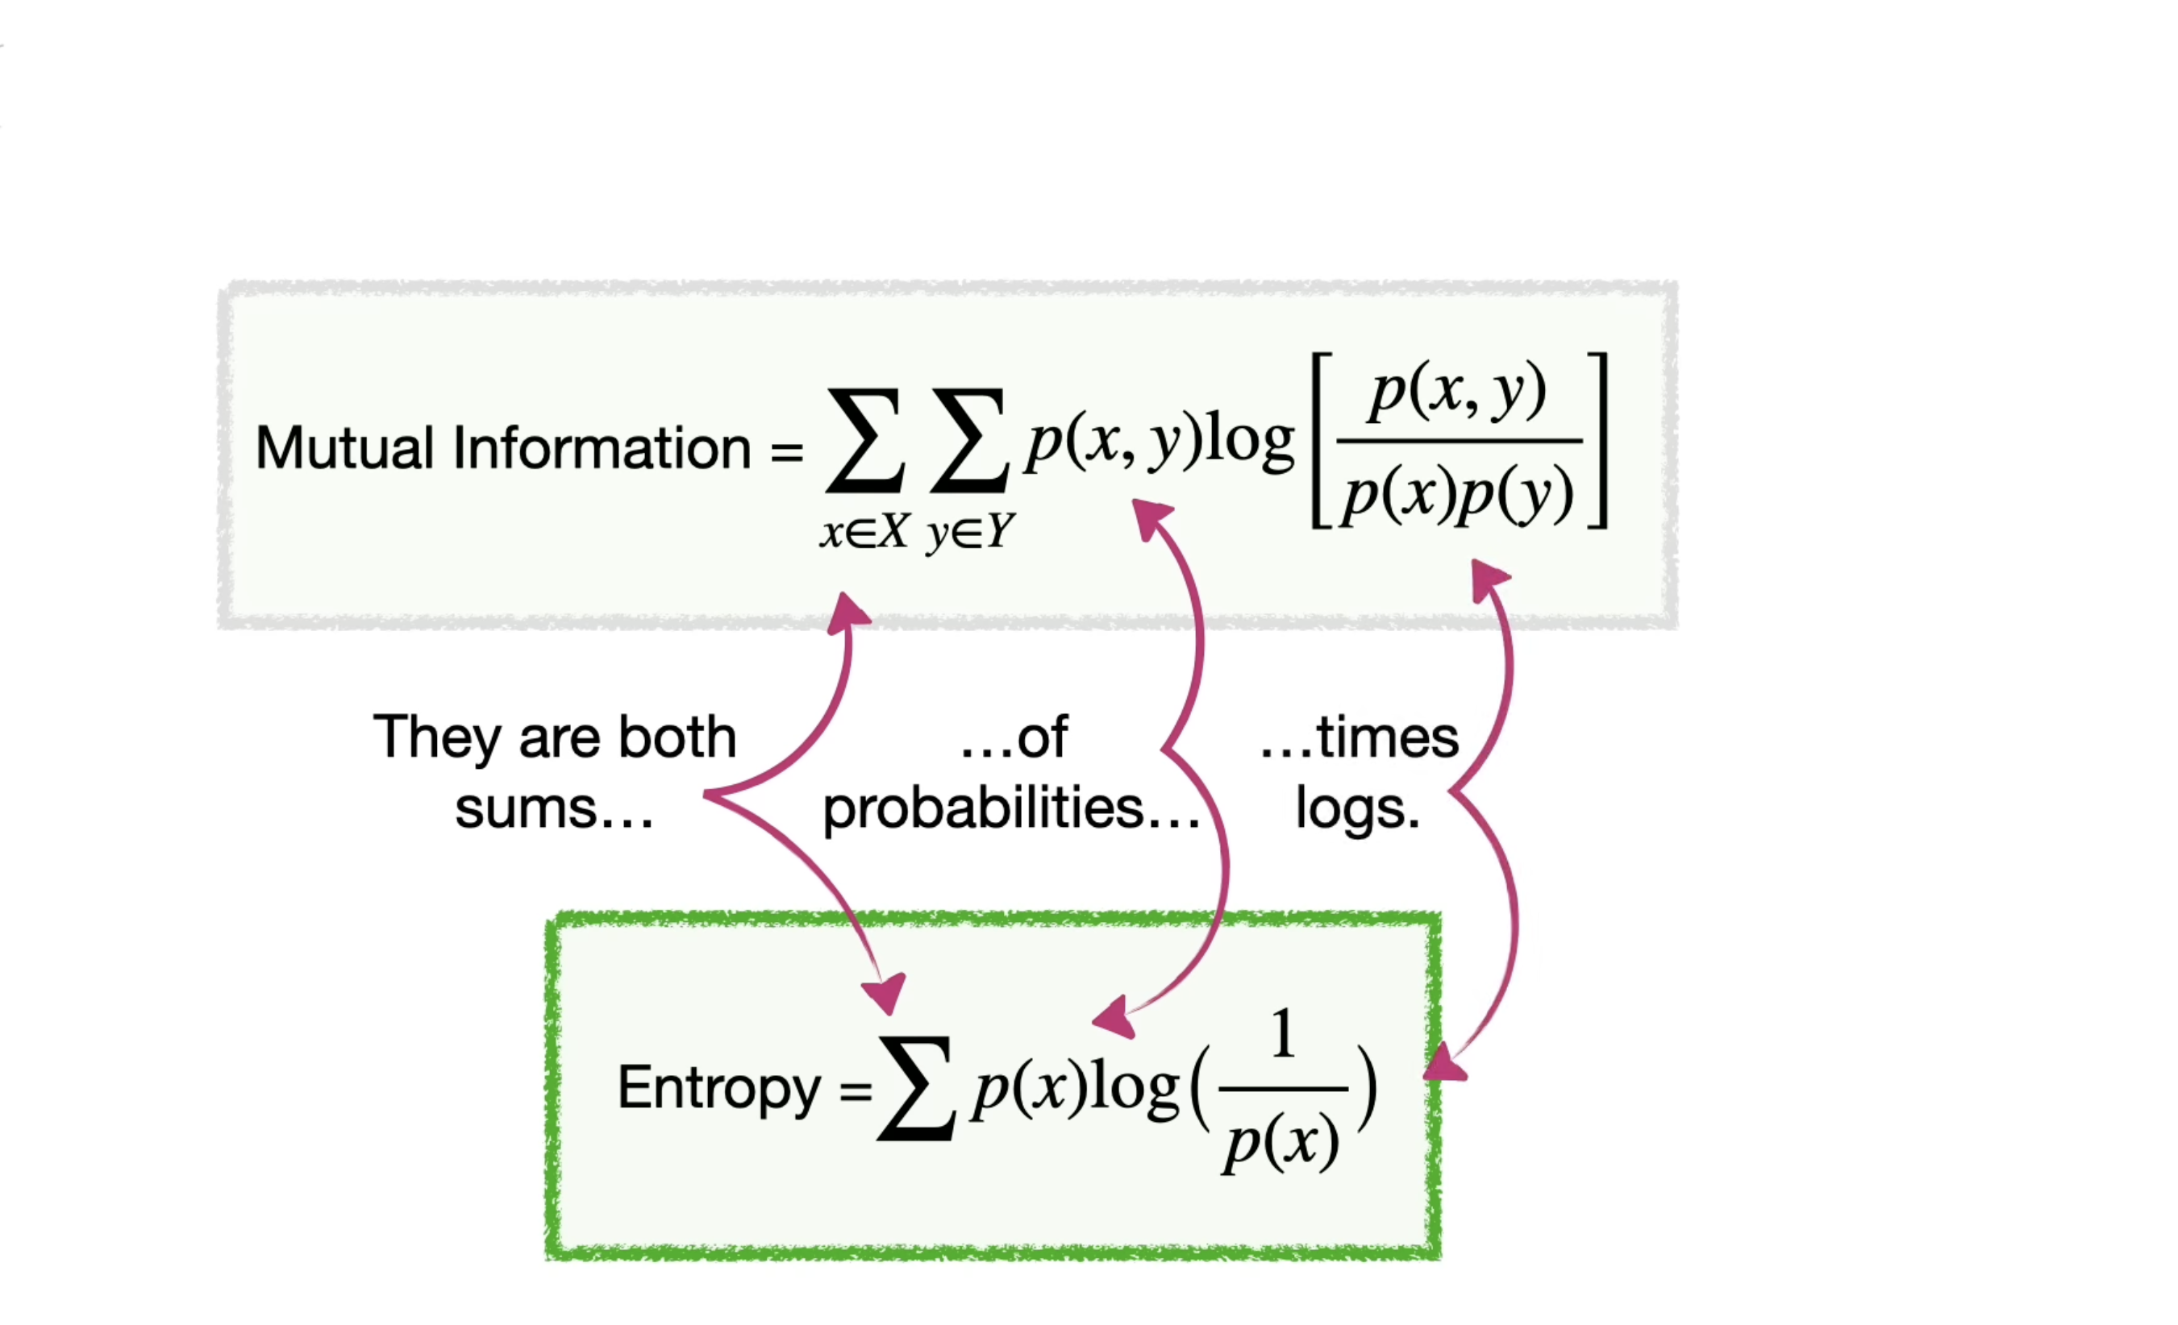

Slide 82
Normalized Mutual Information
Estimating Clustering Quality

Slide 83
Normalized Mutual Information
Normalized Mutual Information:
2 × 𝐼(𝑌; 𝐶)
𝑁𝑀𝐼 𝑌, 𝐶 =
𝐻 𝑌 + 𝐻 𝐶
where,
Y = class labels
C = cluster labels
H(.) = Entropy
4) I(Y;C) = Mutual Information b/w Y and C Note: All logs are base-2.

Slide 84


Calculating NMI for Clustering
Assume m=3 classes and k=2 clusters
Cluster-1 (C=1)
Cluster-2 (C=2)
Class-1 (Y=1)
Class-2 (Y=2)
Class-3 (Y=3)

Slide 85
H(Y) = Entropy of Class Labels
P(Y=1) = 5/20 = ¼
P(Y=3) = 5/20 = ¼
P(Y=2) = 10/20 = ½
1
4
1
4
1
2
H(Y) = − ¹ log
− ¹ log
− ¹ log
= 1.5
4
4
2
This is calculated for the entire dataset and can be calculated prior to clustering, as it will not change depending on the clustering output.

Slide 86
H(C) = Entropy of Cluster Labels
P(C=1) = 10/20 = 1/2
P(C=2) = 10/20 = ½
1
2
H(Y) =− ¹ log
¹ − ¹ log
2 2
= 1
2
This will be calculated every time the clustering changes. You can see from the figure that the clusters are balanced (have equal number of instances).

Slide 87
I(Y;C)= Mutual Information
Mutual information is given as:
– 𝐼 𝑌; 𝐶 = 𝐻 𝑌 − 𝐻 𝑌 𝐶
We already know H(Y)
H(Y|C) is the entropy of class labels within each cluster, how do we calculate this??
Mutual Information tells us the reduction in the entropy of class labels that we get if we know the cluster labels. (Similar to Information gain in deicison trees)

Slide 88
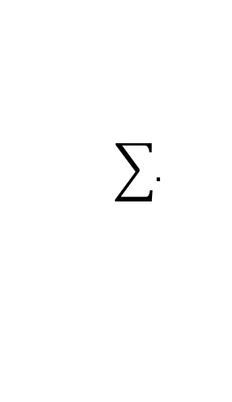
H(Y|C): conditional entropy of class labels for clustering C
Consider Cluster-1:
P(Y=1|C=1)=3/10 (three triangles in cluster-1)
P(Y=2|C=1)=3/10 (three rectangles in cluster-1)
P(Y=3|C=1)=4/10 (four stars in cluster-1)
Calculate conditional entropy as:
$$\sum{.}$$
𝐻 𝑌 𝐶 = 1
= −𝑃(𝐶 = 1)
𝑦∈{1,2,3}
𝑃 𝑌 = 𝑦 𝐶 = 1 log(𝑃 𝑌 = 𝑦 𝐶 = 1 )
1 3
3
10
3
3 4
4
=− ₂ × [ log
+ log( )+ log( )] = 0.7855
10
10
10 10
10

Slide 89
H(Y|C): conditional entropy of class labels for clustering C
Now, consider Cluster-2:
P(Y=1|C=2)=2/10 (two triangles in cluster-1)
P(Y=2|C=2)=7/10 (seven rectangles in cluster-1)
P(Y=3|C=2)=1/10 (one star in cluster-1)
Calculate conditional entropy as:
$$\sum{.}$$
𝐻 𝑌 𝐶 = 2
= −𝑃(𝐶 = 2)
𝑦∈{1,2,3}
𝑃 𝑌 = 𝑦 𝐶 = 2 log(𝑃 𝑌 = 𝑦 𝐶 = 2 )
1 2
2
10
7
7 1
1
=− ₂ × [ log
+ log( )+ log( )] = 0.5784
10
10
10 10
10

Slide 90
I(Y;C)
Finally the mutual information is:
𝐼 𝑌; 𝐶
= 𝐻 𝑌 − 𝐻 𝑌 𝐶
= 1.5 − 0.7855 + 0.5784
= 0.1361
The NMI is therefore,
𝑁𝑀𝐼 𝑌, 𝐶 =
2 × 𝐼(𝑌; 𝐶)
𝐻 𝑌 + 𝐻 𝐶
₌ 2 × 0.1361 _{= 0.1089}
𝑁𝑀𝐼 𝑌, 𝐶
1.5 + 1

Slide 91
NMI
NMI is a good measure for determining the quality of clustering.
It is an external measure because we need the class labels of the instances to determine the NMI.
Since it’s normalized we can measure and compare the NMI between different clusterings having different number of clusters.

Slide 92

NMI for Clustering
Calculate the NMI:
Cluster-1 (C=1)
Cluster-2 (C=2)
Class-1 (Y=1)
Class-2 (Y=2)
Class-3 (Y=3)

Slide 93
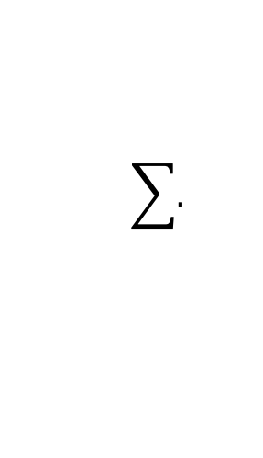
H(Y|C): conditional entropy of class labels for clustering C
Consider Cluster-1:
P(Y=1|C=1)=3/10 (three triangles in cluster-1)
P(Y=2|C=1)=7/10 (seven rectangles in cluster-1)
P(Y=3|C=1)=0/10 (no stars in cluster-1)
Calculate conditional entropy as:
$$\sum{.}$$
𝐻 𝑌 𝐶 = 1
= −𝑃(𝐶 = 1)
𝑃 𝑌 = 𝑦 𝐶 = 1 log(𝑃 𝑌 = 𝑦 𝐶 = 1 )
1 3
3
10
0
0 7
7
=− ₂ × [ log
+ log( )+ log( )] = 0.4406
10
10
10 10
10
We used 0log(0)=0

Slide 94
H(Y|C): conditional entropy of class labels for clustering C
Now, consider Cluster-2:
P(Y=1|C=2)=2/10 (two triangles in cluster-1)
P(Y=2|C=2)=3/10 (three rectangles in cluster-1)
P(Y=3|C=2)=5/10 (five stars in cluster-1)
Calculate conditional entropy as:
$$\sum{.}$$
𝐻 𝑌 𝐶 = 2
= −𝑃(𝐶 = 2)
𝑦∈{1,2,3}
𝑃 𝑌 = 𝑦 𝐶 = 2 log(𝑃 𝑌 = 𝑦 𝐶 = 2 )
1 2
2
10
3
3 5
5
=− ₂ × [ log
+ log( )+ log( )] = 0. 7427
10
10
10 10
10

Slide 95
I(Y;C)
Finally the mutual information is:
𝐼 𝑌; 𝐶
= 𝐻 𝑌 − 𝐻 𝑌 𝐶
= 1.5 − 0.4406 + 0.7427
= 0.3167
The NMI is therefore,
𝑁𝑀𝐼 𝑌, 𝐶 =
2 × 𝐼(𝑌; 𝐶)
𝐻 𝑌 + 𝐻 𝐶
₌ 2 × 0.3167 _{= 0.2533}
𝑁𝑀𝐼 𝑌, 𝐶
1.5 + 1

Slide 96
Comments
NMI for the second clustering is higher than the first clustering. It means we would prefer the second clustering over the first.
– You can see that one of the clusters in the second case contains all instances of class-3 (stars).
If we have to compare two clustering that have different number of clusters we can still use NMI.

Slide 97
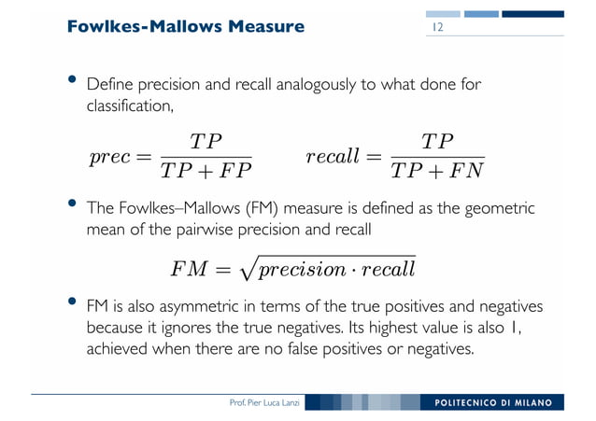

Slide 98
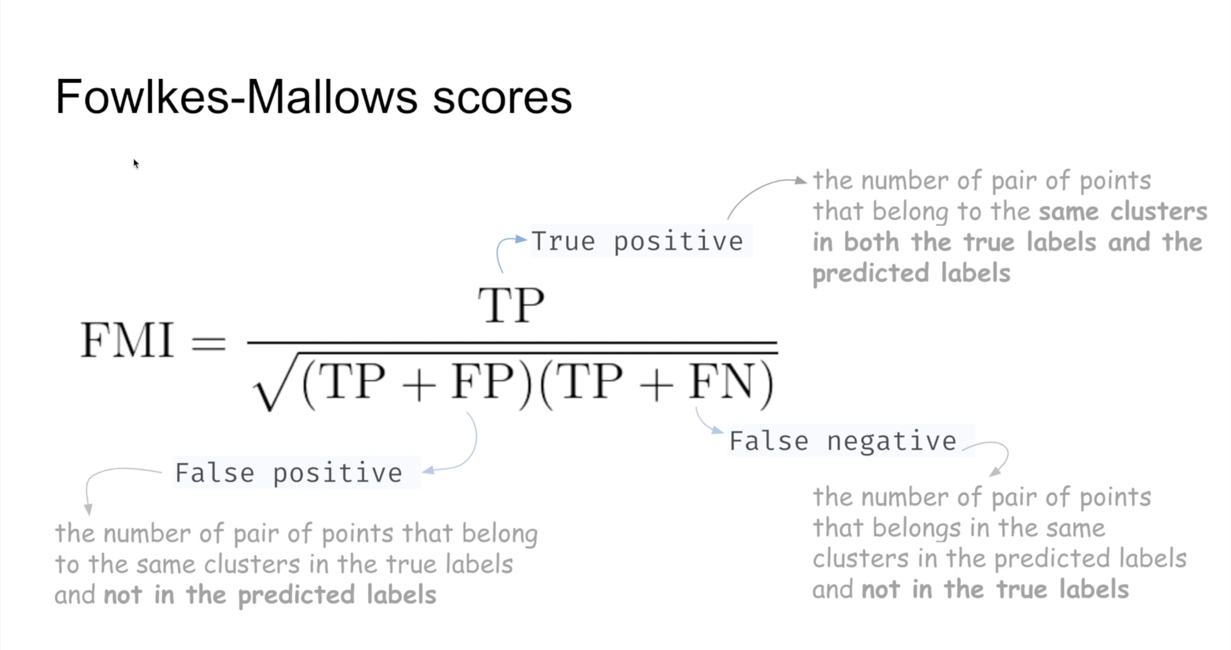

Slide 99
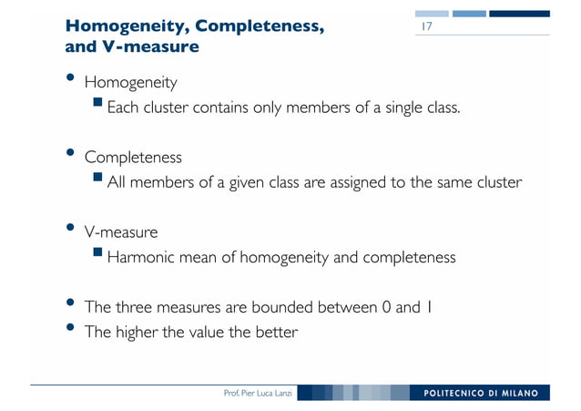

Slide 100
Homogeneity measures the degree to which each cluster contains only data points that are members of a single class in the ground truth or reference clustering.
It quantifies the agreement between the clusters and the true class labels.
A high homogeneity score (close to 1) indicates that each cluster predominantly contains data points from a single class.

Slide 101
Completeness measures the degree to which all data points that are members of a single class in the ground truth or reference clustering are assigned to the same cluster.
It quantifies how well the clusters capture all the data points belonging to a particular class.
A high completeness score (close to 1) indicates that all data points from the same class are assigned to the same cluster.

Slide 102
V-measure is a balanced metric that combines both homogeneity and completeness into a single score.
It takes into account the trade-off between these two aspects of clustering quality.
A high V-measure score (close to 1) indicates that the clustering solution achieves both high homogeneity and high completeness.

Slide 103


Slide 104
Homogeneity measures how well clusters contain data points from a single class.
Completeness measures how well clusters capture all data points belonging to a single class.
V-measure combines both homogeneity and completeness to provide a balanced measure of clustering quality.

